Slide 1
Satisfiability Modulo Theories solvers in Program Analysis and Verification
Leonardo de Moura and Nikolaj Bjørner
Microsoft Research

Slide 2
Tutorial overview
Appetizers
SMT solving
Applications
Applications at Microsoft Research
Background
Basics, DPLL(∅), Equality, Arithmetic, DPLL(T), Arrays, Matching
Z3 – An Efficient SMT solver

Slide 3
SMT
Appetizer

Slide 4
Domains from programs
Bits and bytes
Arithmetic
Arrays
Records
Heaps
Data-types
Object inheritance

Slide 5
Satisfiability Modulo Theories (SMT)
Arithmetic
Arrays
Free Functions

Slide 6
ApplicationsAppetizer

Slide 7
Some takeaways from Applications
SMT solvers are used in several applications:
Program Verification
Program Analysis
Program Exploration
Software Modeling
SMT solvers are
directly applicable, or
disguised beneath a transformation
Theories and quantifiers supply abstractions
Replace ad-hoc, often non-scalable, solutions

Slide 8
Program Verification
Hyper-V
VCC
Boogie
Win. Modules
HAVOC
Verification
condition
Bug path
Rustan Leino, Mike Barnet, Michal Mosƙal, Shaz Qadeer, Shuvendu Lahiri, Herman Venter, Peter Muller,
Wolfram Schulte, Ernie Cohen

Slide 9
Test case generation
Run Test and Monitor
Execution Path
Path Condition
seed
Test Inputs
Known Paths
New input
Constraint System
Solve
Unexplored path
Vigilante
Nikolai Tillmann, Peli de Halleux, Patrice Godefroid
Aditya Nori, Jean Philippe Martin, Miguel Castro,
Manuel Costa, Lintao Zhang

Slide 10
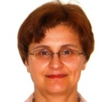
Static Driver Verifier
Z3 is part of SDV 2.0 (Windows 7)
It is used for:
Predicate abstraction (c2bp)
Counter-example refinement (newton)
Ella Bounimova, Vlad Levin, Jakob Lichtenberg,
Tom Ball, Sriram Rajamani, Byron Cook

Slide 11
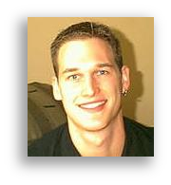
More applications
Bounded model-checking of model programs
Termination
Security protocols, F#/7
Business application modeling
Cryptography
Model Based Testing (SQL-Server)
Verified garbage collectors

Slide 12
Applications

Slide 13
Program Exploration with Pex
Nikolai Tillmann, Peli de Halleux
http://research.microsoft.com/Pex

Slide 14
What is Pex
Test input generator
Pex starts from parameterized unit tests
Generated tests are emitted as traditional unit tests
Dynamic symbolic execution framework
Analysis of .NET instructions (bytecode)
Instrumentation happens automatically at JIT time
Using SMT-solver Z3 to check satisfiability and generate models = test inputs

Slide 15
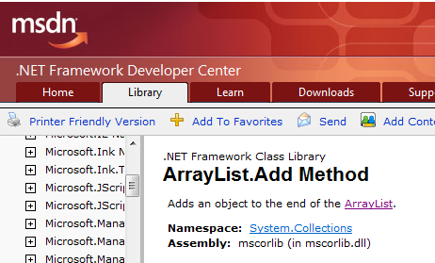
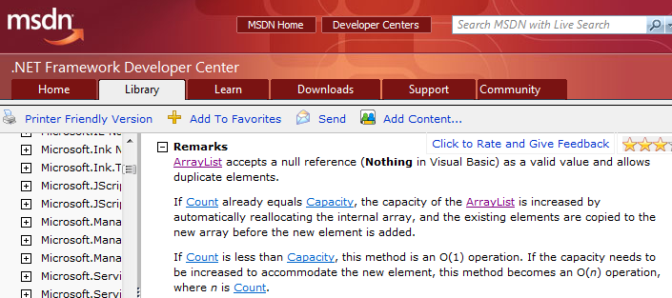
ArrayList: The Spec

Slide 16
ArrayList: AddItem Test
class ArrayListTest { [PexMethod] void AddItem(int c, object item) { var list = new ArrayList(c); list.Add(item);
Assert(list[0] == item); }
}
class ArrayList {
object[] items; int count;
ArrayList(int capacity) {
if (capacity < 0) throw ...;
items = new object[capacity]; }
void Add(object item) {
if (count == items.Length) ResizeArray();
items[this.count++] = item; } ...

Slide 17
ArrayList: Starting Pex…
class ArrayListTest { [PexMethod] void AddItem(int c, object item) { var list = new ArrayList(c); list.Add(item);
Assert(list[0] == item); }
}
 | Inputs
class ArrayList {
object[] items; int count;
ArrayList(int capacity) {
if (capacity < 0) throw ...;
items = new object[capacity]; }
void Add(object item) {
if (count == items.Length) ResizeArray();
items[this.count++] = item; } ...

Slide 18
ArrayList: Run 1, (0,null)
class ArrayListTest { [PexMethod] void AddItem(int c, object item) { var list = new ArrayList(c); list.Add(item);
Assert(list[0] == item); }
}
 | Inputs
 | (0,null)
class ArrayList {
object[] items; int count;
ArrayList(int capacity) {
if (capacity < 0) throw ...;
items = new object[capacity]; }
void Add(object item) {
if (count == items.Length) ResizeArray();
items[this.count++] = item; } ...

Slide 19
ArrayList: Run 1, (0,null)
class ArrayListTest { [PexMethod] void AddItem(int c, object item) { var list = new ArrayList(c); list.Add(item);
Assert(list[0] == item); }
}
 | Inputs | Observed Constraints
 | (0,null) | !(c<0)
class ArrayList {
object[] items; int count;
ArrayList(int capacity) {
if (capacity < 0) throw ...;
items = new object[capacity]; }
void Add(object item) {
if (count == items.Length) ResizeArray();
items[this.count++] = item; } ...
c < 0 → false

Slide 20
ArrayList: Run 1, (0,null)
class ArrayListTest { [PexMethod] void AddItem(int c, object item) { var list = new ArrayList(c); list.Add(item);
Assert(list[0] == item); }
}
 | Inputs | Observed Constraints
 | (0,null) | !(c<0) && 0==c
class ArrayList {
object[] items; int count;
ArrayList(int capacity) {
if (capacity < 0) throw ...;
items = new object[capacity]; }
void Add(object item) {
if (count == items.Length) ResizeArray();
items[this.count++] = item; } ...
0 == c → true

Slide 21
ArrayList: Run 1, (0,null)
class ArrayListTest { [PexMethod] void AddItem(int c, object item) { var list = new ArrayList(c); list.Add(item);
Assert(list[0] == item); }
}
 | Inputs | Observed Constraints
 | (0,null) | !(c<0) && 0==c
item == item → true
class ArrayList {
object[] items; int count;
ArrayList(int capacity) {
if (capacity < 0) throw ...;
items = new object[capacity]; }
void Add(object item) {
if (count == items.Length) ResizeArray();
items[this.count++] = item; } ...
This is a tautology,
i.e. a constraint that is always true,
regardless of the chosen values.
We can ignore such constraints.

Slide 22
ArrayList: Picking the next branch to cover
class ArrayListTest { [PexMethod] void AddItem(int c, object item) { var list = new ArrayList(c); list.Add(item);
Assert(list[0] == item); }
}
Constraints to solve | Inputs | Observed Constraints
 | (0,null) | !(c<0) && 0==c
!(c<0) && 0!=c
class ArrayList {
object[] items; int count;
ArrayList(int capacity) {
if (capacity < 0) throw ...;
items = new object[capacity]; }
void Add(object item) {
if (count == items.Length) ResizeArray();
items[this.count++] = item; } ...

Slide 23
ArrayList: Solve constraints using SMT solver
class ArrayListTest { [PexMethod] void AddItem(int c, object item) { var list = new ArrayList(c); list.Add(item);
Assert(list[0] == item); }
}
Constraints to solve | Inputs | Observed Constraints
 | (0,null) | !(c<0) && 0==c
!(c<0) && 0!=c | (1,null)
class ArrayList {
object[] items; int count;
ArrayList(int capacity) {
if (capacity < 0) throw ...;
items = new object[capacity]; }
void Add(object item) {
if (count == items.Length) ResizeArray();
items[this.count++] = item; } ...
Z3
Constraint solver
Z3 has decision procedures for
Arrays
Linear integer arithmetic
Bitvector arithmetic
…
(Everything but floating-point numbers)

Slide 24
ArrayList: Run 2, (1, null)
class ArrayListTest { [PexMethod] void AddItem(int c, object item) { var list = new ArrayList(c); list.Add(item);
Assert(list[0] == item); }
}
Constraints to solve | Inputs | Observed Constraints
 | (0,null) | !(c<0) && 0==c
!(c<0) && 0!=c | (1,null) | !(c<0) && 0!=c
class ArrayList {
object[] items; int count;
ArrayList(int capacity) {
if (capacity < 0) throw ...;
items = new object[capacity]; }
void Add(object item) {
if (count == items.Length) ResizeArray();
items[this.count++] = item; } ...
0 == c → false

Slide 25
ArrayList: Pick new branch
class ArrayListTest { [PexMethod] void AddItem(int c, object item) { var list = new ArrayList(c); list.Add(item);
Assert(list[0] == item); }
}
Constraints to solve | Inputs | Observed Constraints
 | (0,null) | !(c<0) && 0==c
!(c<0) && 0!=c | (1,null) | !(c<0) && 0!=c
c<0
class ArrayList {
object[] items; int count;
ArrayList(int capacity) {
if (capacity < 0) throw ...;
items = new object[capacity]; }
void Add(object item) {
if (count == items.Length) ResizeArray();
items[this.count++] = item; } ...

Slide 26
ArrayList: Run 3, (-1, null)
class ArrayListTest { [PexMethod] void AddItem(int c, object item) { var list = new ArrayList(c); list.Add(item);
Assert(list[0] == item); }
}
Constraints to solve | Inputs | Observed Constraints
 | (0,null) | !(c<0) && 0==c
!(c<0) && 0!=c | (1,null) | !(c<0) && 0!=c
c<0 | (-1,null)
class ArrayList {
object[] items; int count;
ArrayList(int capacity) {
if (capacity < 0) throw ...;
items = new object[capacity]; }
void Add(object item) {
if (count == items.Length) ResizeArray();
items[this.count++] = item; } ...

Slide 27
ArrayList: Run 3, (-1, null)
class ArrayListTest { [PexMethod] void AddItem(int c, object item) { var list = new ArrayList(c); list.Add(item);
Assert(list[0] == item); }
}
Constraints to solve | Inputs | Observed Constraints
 | (0,null) | !(c<0) && 0==c
!(c<0) && 0!=c | (1,null) | !(c<0) && 0!=c
c<0 | (-1,null) | c<0
class ArrayList {
object[] items; int count;
ArrayList(int capacity) {
if (capacity < 0) throw ...;
items = new object[capacity]; }
void Add(object item) {
if (count == items.Length) ResizeArray();
items[this.count++] = item; } ...
c < 0 → true

Slide 28
ArrayList: Run 3, (-1, null)
class ArrayListTest { [PexMethod] void AddItem(int c, object item) { var list = new ArrayList(c); list.Add(item);
Assert(list[0] == item); }
}
Constraints to solve | Inputs | Observed Constraints
 | (0,null) | !(c<0) && 0==c
!(c<0) && 0!=c | (1,null) | !(c<0) && 0!=c
c<0 | (-1,null) | c<0
class ArrayList {
object[] items; int count;
ArrayList(int capacity) {
if (capacity < 0) throw ...;
items = new object[capacity]; }
void Add(object item) {
if (count == items.Length) ResizeArray();
items[this.count++] = item; } ...

Slide 29
Pex – Test more with less effort
Reduce testing costs
Automated analysis, reproducible results
Produce more secure software
White-box code analysis
Produce more reliable software
Analysis based on contracts written as code

Slide 30
White box testing in practice
How to test this code?
(Real code from .NET base class libraries.)

Slide 31
White box testing in practice

Slide 32
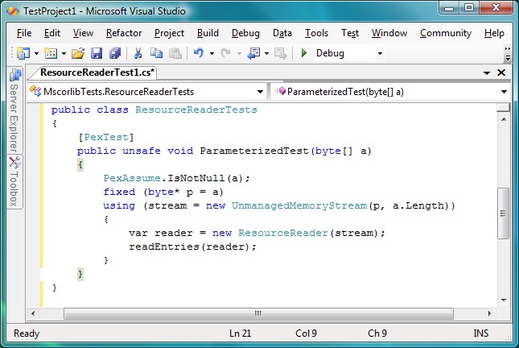
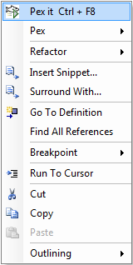
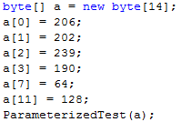
Pex – Test Input Generation tomorrow
Test input, generated by Pex
32

Slide 33
Test Input Generation by Dynamic Symbolic Execution
Initially, choose Arbitrary
Run Test and Monitor
Solve
Test Inputs
Constraint System
Execution Path
Known Paths
Choose an
Uncovered Path
Record
Path Condition
Result: small test suite, high code coverage
Finds only real bugs
No false warnings

Slide 34
Test Input Generation by Dynamic Symbolic Execution
a[0] = 0;
a[1] = 0;
a[2] = 0;
a[3] = 0;
…
Initially, choose Arbitrary
Run Test and Monitor
Solve
Test Inputs
Constraint System
Execution Path
Known Paths
Choose an
Uncovered Path
Record
Path Condition
Result: small test suite, high code coverage
Finds only real bugs
No false warnings

Slide 35
Test Input Generation by Dynamic Symbolic Execution
Initially, choose Arbitrary
Path Condition:
… ⋀ magicNum != 0x95673948
Run Test and Monitor
Solve
Test Inputs
Constraint System
Execution Path
Known Paths
Choose an
Uncovered Path
Record
Path Condition
Result: small test suite, high code coverage
Finds only real bugs
No false warnings

Slide 36
Test Input Generation by Dynamic Symbolic Execution
Initially, choose Arbitrary
Run Test and Monitor
… ⋀ magicNum != 0x95673948
… ⋀ magicNum == 0x95673948
Solve
Test Inputs
Constraint System
Execution Path
Known Paths
Choose an
Uncovered Path
Record
Path Condition
Result: small test suite, high code coverage
Finds only real bugs
No false warnings

Slide 37
Test Input Generation by Dynamic Symbolic Execution
a[0] = 206;
a[1] = 202;
a[2] = 239;
a[3] = 190;
Initially, choose Arbitrary
Run Test and Monitor
Solve
Test Inputs
Constraint System
Execution Path
Known Paths
Choose an
Uncovered Path
Record
Path Condition
Result: small test suite, high code coverage
Finds only real bugs
No false warnings

Slide 38
Test Input Generation by Dynamic Symbolic Execution
Initially, choose Arbitrary
Run Test and Monitor
Solve
Test Inputs
Constraint System
Execution Path
Known Paths
Choose an
Uncovered Path
Record
Path Condition
Result: small test suite, high code coverage
Finds only real bugs
No false warnings

Slide 39
Automatic Test Input Generation:
Whole-program, white box code analysis
Initially, choose Arbitrary
Run Test and Monitor
Solve
Test Inputs
Constraint System
Execution Path
Known Paths
Choose an
Uncovered Path
Record
Path Condition
Result: small test suite, high code coverage
Finds only real bugs
No false warnings

Slide 40
Constraint Solving: Preprocessing
Independent constraint optimization + Constraint caching (similar to EXE)
Idea: Related execution paths give rise to "similar" constraint systems
Example: Consider x>y ⋀ z>0 vs. x>y ⋀ z<=0
If we already have a cached solution for a "similar" constraint system, we can reuse it
x=1, y=0, z=1 is solution for x>y ⋀ z>0
we can obtain a solution for x>y ⋀ z<=0 by
reusing old solution of x>y: x=1, y=0
combining with solution of z<=0: z=0

Slide 41
Constraint Solving: Z3
Rich Combination: Solvers for uninterpreted functions with equalities, linear integer arithmetic, bitvector arithmetic, arrays, tuples
Formulas may be a big conjunction
Pre-processing step
Eliminate variables and simplify input format
Universal quantifiers
Used to model custom theories, e.g. .NET type system
Model generation
Models used as test inputs
Incremental solving
Given a formula F, find a model M, that minimizes the value of the variables x₀ … x_{n}
Push / Pop of contexts for model minimization
Programmatic API
For small constraint systems, text through pipes would add huge overhead

Slide 42
Monitoring by Code Instrumentation
ldtoken Point::X
call __Monitor::LDFLD_REFERENCE
ldfld Point::X
call __Monitor::AtDereferenceFallthrough
br L2
L1:
call __Monitor::AtBranchTarget
call __Monitor::LDC_I4_M1
ldc.i4.m1
L2:
call __Monitor::RET
stloc.0
leave L4
} catch NullReferenceException {
‘ call __Monitor::AtNullReferenceException
rethrow
}
L4: leave L5
} finally {
call __Monitor::LeaveMethod
endfinally
}
L5: ldloc.0
ret
class Point { int x; int y;
public static int GetX(Point p) {
if (p != null) return p.X;
else return -1; } }
ldtoken Point::GetX
call __Monitor::EnterMethod
brfalse L0
ldarg.0
call __Monitor::NextArgument<Point>
L0: .try {
.try {
call __Monitor::LDARG_0
ldarg.0
call __Monitor::LDNULL
ldnull
call __Monitor::CEQ
ceq
call __Monitor::BRTRUE
brtrue L1
call __Monitor::BranchFallthrough
call __Monitor::LDARG_0
ldarg.0
…
Prologue
Record concrete values to have all information when this method is called with no proper context
(The real C# compiler output is actually more complicated.)
Calls to build path condition
Calls will perform symbolic computation
Epilogue
Calls to build path condition

Slide 43
Spec# and Boogie
Rustan Leino & Mike Barnett

Slide 44
Verifying Compilers
A verifying compiler uses automated reasoning to check the
correctness of a program that is compiles.
Correctness is specified by types, assertions, . . . and other
redundant annotations that accompany the program.
Tony Hoare 2004

Slide 45
Spec# Approach for a Verifying Compiler
Source Language
C# + goodies = Spec#
Specifications
method contracts,
invariants,
field and type annotations.
Program Logic:
Dijkstra’s weakest preconditions.
Automatic Verification
type checking,
verification condition generation (VCG),
automatic theorem proving Z3
Spec# (annotated C#)
Spec# Compiler
Boogie PL
VC Generator
Formulas
Z3

Slide 46
Basic verifier architecture
Source language
Intermediate verification language
Verification condition (logical formula)

Slide 47
Verification architecture
Spec#
C
C
Dafny
Spec# compiler
Dafny verifier
VCC
HAVOC
MSIL
Bytecode translator
V
Boogie
Inference engine
Boogie
Static program verifier (Boogie)
V.C. generator
Verification condition
Z3
Z3
“correct” or list of errors

Slide 48
Modeling execution traces
terminates
…
diverges
goes wrong

Slide 49
States and execution traces
State
Cartesian product of variables
Execution trace
Nonempty finite sequence of states
Infinite sequence of states
Nonempty finite sequence of states followed by special error state
(x: int, y: int, z: bool)
…

Slide 50
Command language
P
assert P
assume P
x := E
x := x + 1
x := 10
havoc x
¬P
P

Slide 51
Command language
P
x := E
x := x + 1
x := 10
havoc x
S ; T
assert P
assume P
¬P
P
…
…

Slide 52
Command language
P
assert P
assume P
S T
x := E
x := x + 1
x := 10
havoc x
S ; T
¬P
P
…

Slide 53
Reasoning about execution traces
Hoare triple { P } S { Q } says that
every terminating execution trace of S that starts in a state satisfying P
does not go wrong, and
terminates in a state satisfying Q

Slide 54
Reasoning about execution traces
Hoare triple { P } S { Q } says that
every terminating execution trace of S that starts in a state satisfying P
does not go wrong, and
terminates in a state satisfying Q
Given S and Q, what is the weakest P’ satisfying {P’} S {Q} ?
P' is called the weakest precondition of S with respect to Q, written wp(S, Q)
to check {P} S {Q}, check P ⇒ P’

Slide 55
Weakest preconditions
Q[ E / x ]
(∀x • Q )
P ∧ Q
P ⇒ Q
wp( S, wp( T, Q ))
wp( S, Q ) ∧ wp( T, Q )
wp( x := E, Q ) =
wp( havoc x, Q ) =
wp( assert P, Q ) =
wp( assume P, Q ) =
wp( S ; T, Q ) =
wp( S T, Q ) =

Slide 56
Structured if statement
if E then S else T end =
assume E; S
assume ¬E; T

Slide 57
Dijkstra's guarded command
if E → S | F → T fi =
assert E ∨ F;
(
assume E; S
assume F; T
)

Slide 58
Picking any good value
assign x such that P =
havoc x; assume P
assign x such that x*x = y
P
;
=
¬P

Slide 59
Procedures
A procedure is a user-defined command
procedure M(x, y, z) returns (r, s, t) requires P modifies g, h ensures Q

Slide 60
Procedure example
procedure Inc(n) returns (b) requires 0 ≤ n modifies g ensures g = old(g) + n

Slide 61
Procedures
A procedure is a user-defined command
procedure M(x, y, z) returns (r, s, t) requires P modifies g, h ensures Q
call a, b, c := M(E, F, G) = x’ := E; y’ := F; z’ := G; assert P’; g0 := g; h0 := h; havoc g, h, r’, s’, t’; assume Q’; a := r’; b := s’; c := t’
where
x’, y’, z’, r’, s’, t’, g0, h0 are fresh names
P’ is P with x’,y’,z’ for x,y,z
Q’ is Q with x’,y’,z’,r’,s’,t’,g0,h0 for x,y,z,r,s,t, old(g), old(h)

Slide 62
Procedure implementations
procedure M(x, y, z) returns (r, s, t) requires P modifies g, h ensures Q
implementation M(x, y, z) returns (r, s, t) is S
= assume P; g0 := g; h0 := h;
S; assert Q’
where
g0, h0 are fresh names
Q’ is Q with g0,h0 for old(g), old(h)
syntactically check that S assigns only to g,h

Slide 63
While loop with loop invariant
while E invariant J do S end
= assert J; havoc x; assume J; ( assume E; S; assert J; assume false assume ¬E )
where x denotes the assignment targets of S
check that the loop invariant holds initially
“fast forward” to an arbitrary iteration of the loop
check that the loop invariant is maintained by the loop body

Slide 64
Properties of the heap
introduce:
axiom (∀ h: HeapType, o: Ref, f: Field Ref • o ≠ null ∧ h[o, alloc] ⇒ h[o, f] = null ∨ h[ h[o,f], alloc ] );

Slide 65
Properties of the heap
introduce:
function IsHeap(HeapType) returns (bool);
introduce:
axiom (∀ h: HeapType, o: Ref, f: Field Ref • IsHeap(h) ∧ o ≠ null ∧ h[o, alloc] ⇒ h[o, f] = null ∨ h[ h[o,f], alloc ] );
introduce: assume IsHeap(Heap) after each Heap update; for example: Tr[[ E.x := F ]] = assert …; Heap[…] := …; assume IsHeap(Heap)

Slide 66
Methods
method M(x: X) returns (y: Y) requires P; modifies S; ensures Q; { Stmt }
procedure M(this: Ref, x: Ref) returns (y: Ref);
free requires IsHeap(Heap); free requires this ≠ null ∧ Heap[this, alloc]; free requires x = null ∨ Heap[x, alloc];
requires Df[[ P ]] ∧ Tr[[ P ]];
requires Df[[ S ]];
modifies Heap;
ensures Df[[ Q ]] ∧ Tr[[ Q ]];
ensures (∀⟨α⟩ o: Ref, f: Field α • o ≠ null ∧ old(Heap)[o,alloc] ⇒ Heap[o,f] = old(Heap)[o,f] ∨ (o,f) ∈ old( Tr[[ S ]] ));
free ensures IsHeap(Heap); free ensures y = null ∨ Heap[y, alloc]; free ensures (∀o: Ref • old(Heap)[o,alloc] ⇒ Heap[o,alloc]);

Slide 67
Spec# Chunker.NextChunk translation
procedure Chunker.NextChunk(this: ref where $IsNotNull(this, Chunker)) returns ($result: ref where $IsNotNull($result, System.String));
// in-parameter: target object
free requires $Heap[this, $allocated];
requires ($Heap[this, $ownerFrame] == $PeerGroupPlaceholder || !($Heap[$Heap[this, $ownerRef], $inv] <: $Heap[this, $ownerFrame]) || $Heap[$Heap[this, $ownerRef], $localinv] == $BaseClass($Heap[this, $ownerFrame])) && (forall $pc: ref :: $pc != null && $Heap[$pc, $allocated] && $Heap[$pc, $ownerRef] == $Heap[this, $ownerRef] && $Heap[$pc, $ownerFrame] == $Heap[this, $ownerFrame] ==> $Heap[$pc, $inv] == $typeof($pc) && $Heap[$pc, $localinv] == $typeof($pc));
// out-parameter: return value
free ensures $Heap[$result, $allocated];
ensures ($Heap[$result, $ownerFrame] == $PeerGroupPlaceholder || !($Heap[$Heap[$result, $ownerRef], $inv] <: $Heap[$result, $ownerFrame]) || $Heap[$Heap[$result, $ownerRef], $localinv] == $BaseClass($Heap[$result, $ownerFrame])) && (forall $pc: ref :: $pc != null && $Heap[$pc, $allocated] && $Heap[$pc, $ownerRef] == $Heap[$result, $ownerRef] && $Heap[$pc, $ownerFrame] == $Heap[$result, $ownerFrame] ==> $Heap[$pc, $inv] == $typeof($pc) && $Heap[$pc, $localinv] == $typeof($pc));
// user-declared postconditions
ensures $StringLength($result) <= $Heap[this, Chunker.ChunkSize];
// frame condition
modifies $Heap;
free ensures (forall $o: ref, $f: name :: { $Heap[$o, $f] } $f != $inv && $f != $localinv && $f != $FirstConsistentOwner && (!IsStaticField($f) || !IsDirectlyModifiableField($f)) && $o != null && old($Heap)[$o, $allocated] && (old($Heap)[$o, $ownerFrame] == $PeerGroupPlaceholder || !(old($Heap)[old($Heap)[$o, $ownerRef], $inv] <: old($Heap)[$o, $ownerFrame]) || old($Heap)[old($Heap)[$o, $ownerRef], $localinv] == $BaseClass(old($Heap)[$o, $ownerFrame])) && old($o != this || !(Chunker <: DeclType($f)) || !$IncludedInModifiesStar($f)) && old($o != this || $f != $exposeVersion) ==> old($Heap)[$o, $f] == $Heap[$o, $f]);
// boilerplate
free requires $BeingConstructed == null;
free ensures (forall $o: ref :: { $Heap[$o, $localinv] } { $Heap[$o, $inv] } $o != null && !old($Heap)[$o, $allocated] && $Heap[$o, $allocated] ==> $Heap[$o, $inv] == $typeof($o) && $Heap[$o, $localinv] == $typeof($o));
free ensures (forall $o: ref :: { $Heap[$o, $FirstConsistentOwner] } old($Heap)[old($Heap)[$o, $FirstConsistentOwner], $exposeVersion] == $Heap[old($Heap)[$o, $FirstConsistentOwner], $exposeVersion] ==> old($Heap)[$o, $FirstConsistentOwner] == $Heap[$o, $FirstConsistentOwner]);
free ensures (forall $o: ref :: { $Heap[$o, $localinv] } { $Heap[$o, $inv] } old($Heap)[$o, $allocated] ==> old($Heap)[$o, $inv] == $Heap[$o, $inv] && old($Heap)[$o, $localinv] == $Heap[$o, $localinv]);
free ensures (forall $o: ref :: { $Heap[$o, $allocated] } old($Heap)[$o, $allocated] ==> $Heap[$o, $allocated]) && (forall $ot: ref :: { $Heap[$ot, $ownerFrame] } { $Heap[$ot, $ownerRef] } old($Heap)[$ot, $allocated] && old($Heap)[$ot, $ownerFrame] != $PeerGroupPlaceholder ==> old($Heap)[$ot, $ownerRef] == $Heap[$ot, $ownerRef] && old($Heap)[$ot, $ownerFrame] == $Heap[$ot, $ownerFrame]) && old($Heap)[$BeingConstructed, $NonNullFieldsAreInitialized] == $Heap[$BeingConstructed, $NonNullFieldsAreInitialized];

Slide 68
Z3 & Program Verification
Quantifiers, quantifiers, quantifiers, …
Modeling the runtime
Frame axioms (“what didn’t change”)
Users provided assertions (e.g., the array is sorted)
Prototyping decision procedures (e.g., reachability, heaps, …)
Solver must be fast in satisfiable instances.
Trade-off between precision and performance.
Candidate (Potential) Models

Slide 69
The Static Driver Verifier
SLAM
Ella Bounimova, Vlad Levin, Jakob Lichtenberg,
Tom Ball, Sriram Rajamani, Byron Cook

Slide 70
Overview
http://research.microsoft.com/slam/
SLAM/SDV is a software model checker.
Application domain: device drivers.
Architecture:
c2bp C program → boolean program (predicate abstraction).
bebop Model checker for boolean programs.
newton Model refinement (check for path feasibility)
SMT solvers are used to perform predicate abstraction and to check path feasibility.
c2bp makes several calls to the SMT solver. The formulas are relatively small.

Slide 71
Example
Do this code obey the looking rule?
do {
KeAcquireSpinLock();
nPacketsOld = nPackets;
if(request){
request = request->Next;
KeReleaseSpinLock();
nPackets++;
}
} while (nPackets != nPacketsOld);
KeReleaseSpinLock();

Slide 72
Example
Model checking Boolean program
U
do {
KeAcquireSpinLock();
if(*){
KeReleaseSpinLock();
}
} while (*);
KeReleaseSpinLock();
L
L
L
U
L
U
L
U
U
E

Slide 73
Example
Is error path feasible?
U
do {
KeAcquireSpinLock();
nPacketsOld = nPackets;
if(request){
request = request->Next;
KeReleaseSpinLock();
nPackets++;
}
} while (nPackets != nPacketsOld);
KeReleaseSpinLock();
L
L
L
U
L
U
L
U
U
E

Slide 74
Example
Add new predicate to
Boolean program
b: (nPacketsOld == nPackets)
U
do {
KeAcquireSpinLock();
nPacketsOld = nPackets;
if(request){
request = request->Next;
KeReleaseSpinLock();
nPackets++;
}
} while (nPackets != nPacketsOld);
KeReleaseSpinLock();
L
b = true;
L
L
U
b = b ? false : *;
L
U
!b
L
U
U
E

Slide 75
Example
Model Checking
Refined Program
b: (nPacketsOld == nPackets)
U
do {
KeAcquireSpinLock();
b = true;
if(*){
KeReleaseSpinLock();
b = b ? false : *;
}
} while (!b);
KeReleaseSpinLock();
L
b
L
L
b
U
b
b
L
U
!b
b
L
U
b
U
E

Slide 76
Example
Model Checking
Refined Program
b: (nPacketsOld == nPackets)
U
do {
KeAcquireSpinLock();
b = true;
if(*){
KeReleaseSpinLock();
b = b ? false : *;
}
} while (!b);
KeReleaseSpinLock();
L
b
L
L
b
U
b
b
L
U
!b
b
L
b
U

Slide 77
Example
Model Checking
Refined Program
b: (nPacketsOld == nPackets)
U
do {
KeAcquireSpinLock();
b = true;
if(*){
KeReleaseSpinLock();
b = b ? false : *;
}
} while (!b);
KeReleaseSpinLock();
L
b
L
L
b
U
b
b
L
U
!b
b
L
b
U

Slide 78
Observations about SLAM
Automatic discovery of invariants
driven by property and a finite set of (false) execution paths
predicates are not invariants, but observations
abstraction + model checking computes inductive invariants (boolean combinations of observations)
A hybrid dynamic/static analysis
newton executes path through C code symbolically
c2bp+bebop explore all paths through abstraction
A new form of program slicing
program code and data not relevant to property are dropped
non-determinism allows slices to have more behaviors

Slide 79
Syntatic Sugar
goto L1, L2;
L1: assume(e);
S1;
goto L3;
L2: assume(!e);
S2;
goto L3;
L3: S3;
if (e) {
S1;
} else {
S2;
}
S3;

Slide 80
Predicate Abstraction: c2bp
Given a C program P and F = {p₁, … , p_{n}}.
Produce a Boolean program B(P, F)
Same control flow structure as P.
Boolean variables {b₁, … , b_{n}} to match {p₁, … , p_{n}}.
Properties true in B(P, F) are true in P.
Each p_{i} is a pure Boolean expression.
Each p_{i} represents set of states for which p_{i} is true.
Performs modular abstraction.

Slide 81
Abstracting Assignments via WP
Statement y=y+1 and F={ y<4, y<5 }
{y<4}, {y<5} = ((!{y<5} || !{y<4}) ? false : *), {y<4})
WP(x=e,Q) = Q[e/x]
WP(y=y+1, y<5) =
(y<5) [y+1/y] =
(y+1<5) =
(y<4)

Slide 82
WP Problem
WP(s, p_{i}) is not always expressible via {p₁, …, p_{n}}
Example:
F = { x==0, x==1, x < 5}
WP(x = x+1, x < 5) = x < 4

Slide 83
Abstracting Expressions via F
Implies_{F} (e)
Best Boolean function over F that implies e.
ImpliedBy_{F} (e)
Best Boolean function over F that is implied by e.
ImpliedBy_{F} (e) = not Implies_{F} (not e)

Slide 84
Implies_{F}(e) and ImpliedBy_{F}(e)
e
ImpliedBy_{F}(e)
Implies_{F}(e)

Slide 85
Computing Implies_{F}(e)
minterm m = l₁ ∧ ... ∧ l_{n}, where l_{i} = p_{i}, or l_{i} = not p_{i}.
Implies_{F} (e): disjunction of all minterms that imply e.
Naive approach
Generate all 2^{n} possible minterms.
For each minterm m, use SMT solver to check validity of m ⇒ e.
Many possible optimizations

Slide 86
Computing Implies_{F}(e)
F = { x < y, x = 2}
e : y > 1
Minterms over F
!x<y, !x=2 implies y>1
x<y, !x=2 implies y>1
!x<y, x=2 implies y>1
x<y, x=2 implies y>1
Implies_{F}(y>1) = x<y ∧ x=2
Implies_{F}(y>1) = b₁ ∧ b₂

Slide 87
Abstracting Assignments
if Implies_{F}(WP(s, p_{i})) is true before s then
p_{i} is true after s
if Implies_{F}(WP(s, !p_{i})) is true before s then
p_{i} is false after s
{p_{i}} = Implies_{F}(WP(s, p_{i})) ? true :
Implies_{F}(WP(s, !p_{i})) ? false
: *;

Slide 88
Assignment Example
Statement: y = y + 1 Predicates: {x == y}
Weakest Precondition:
WP(y = y + 1, x==y) = x == y + 1
Implies_{F}( x==y+1 ) = false
Implies_{F}( x!=y+1 ) = x==y
Abstraction of y = y +1
{x == y} = {x == y} ? false : *;

Slide 89
Abstracting Assumes
WP(assume(e), Q) = e implies Q
assume(e) is abstracted to:
assume( ImpliedBy_{F}(e) )
Example:
F = {x==2, x<5}
assume(x < 2) is abstracted to:
assume(!{x==2} && {x<5})

Slide 90
Newton
Given an error path p in the Boolean program B.
Is p a feasible path of the corresponding C program?
Yes: found a bug.
No: find predicates that explain the infeasibility.
Execute path symbolically.
Check conditions for inconsistency using SMT solver.

Slide 91
Z3 & Static Driver Verifier
All-SAT
Better (more precise) Predicate Abstraction
Unsatisfiable cores
Why the abstract path is not feasible?
Fast Predicate Abstraction

Slide 92
Unsatisfiable cores
Let S be an unsatisfiable set of formulas.
S’ ⊆ S is an unsatisfiable core of S if:
S’ is also unsatisfiable, and
There is not S’’ ⊂ S’ that is also unsatisfiable.
Computing Implies_{F}(e) with F = {p₁, p_{2,} p_{3,} p₄}
Assume p₁, p₂, p₃, p₄ ⇒ e is valid
That is p₁, p₂, p₃, p₄, ¬e is unsat
Now assume p₁, p₃, ¬e is the unsatisfiable core
Then it is unnecessary to check:
p₁, ¬ p₂, p₃, p₄ ⇒ e
p₁, ¬ p₂, p₃, ¬ p₄ ⇒ e
p₁, p₂, p₃, ¬ p₄ ⇒ e

Slide 93
A Verifying C Compiler
Ernie Cohen, Michal Moskal, Herman Venter, Wolfram Schulte
+ Microsoft Aachen + Verisoft Saarbrücken

Slide 94
Microsoft Hypervisor
Meta OS: small layer of software between hardware and OS
Mini: 60K lines of non-trivial concurrent systems C code
Critical: must provide functional resource abstraction
Trusted: a grand verification challenge
Hypervisor
Hardware

Slide 95
Hypervisor Architecture
is well layered!

Slide 96
What is to be verified?
Source code
C + x64 assembly
Sample verifiable slices:
Safety: Basic memory safety
Functionality: Hypervisor simulates a number of virtual x64 machines.
Utility: Hypervisor services guest OS with available resources.

Slide 97
HAVOC
Verifying Windows Components
Lahiri & Qadeer, POPL’08,
Also: Ball, Hackett, Lahiri, Qadeer, MSR-TR-08-82.

Slide 98
HAVOC's Architecture

Slide 99
Heaps and Shapes
Representative shape graph in Windows Kernel component
Doubly linked lists in Windows Kernel code

Slide 100
Precise and expressive heap reasoning
q
IRP
IRP
p
link
link
next
prev
next
prev
state
state
Pointer Arithmetic q = CONTAINING_RECORD(p, IRP, link) = (IRP *) ((char*)p – (char*)(&(((IRP *)0)→link)))
Transitive Closure Reach(next, u) ≡ {u, u->next, u->next->next, …} forall (x, Reach(next,p), CONTAINING_RECORD(x, IRP, link)->state == PENDING)
PENDING
PENDING

Slide 101
Annotation Language & Logic
Procedure contracts
requires, ensures, modifies
Arbitrary C expressions
program variables, resources
Boolean connectives
quantifiers
Can express a rich set of contracts
API usage (e.g. lock acquire/release)
Synchronization protocols
Memory safety
Data structure invariants (linked list)
Challenge:
Retain efficiency
Decidable fragments

Slide 102
Efficient logic for program verification
Logic with Reach, Quantifiers, Arithmetic
Expressive
Careful use of quantifiers
Efficient logic
Only NP-complete
Encoding using quantifiers and triggers

Slide 103
Combining Random Testing with Model Checking
Aditya Nori, Sriram Rajamani,
ISSTA08: Proofs from Tests. Nels E. Beckman, Nori, Rajamani, Rob Simmons

Slide 104
DASH Algorithm
Input:
Program P
Property ψ
Main workhorse: test case generation
Use counterexamples from current abstraction to “extend frontier” and generate tests
When test case generation fails, use this information to “refine” abstraction at the frontier
Use only aliases that happen on the tests!
Construct initial abstraction
Construct random tests
Test succeeded?
yes
Bug!
no
Abstractionsucceeded?
yes
Proof!
no
τ = error path in abstraction
f = frontier of error path
Can extend test beyond frontier?
yes
no
Refine abstraction

Slide 105
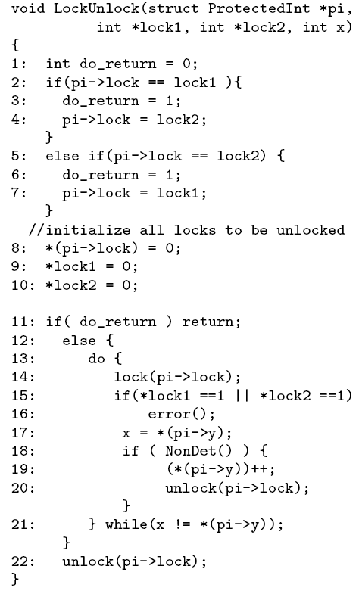
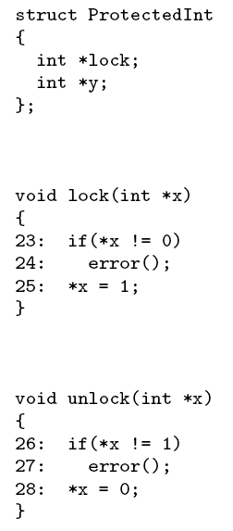
Example

Slide 106
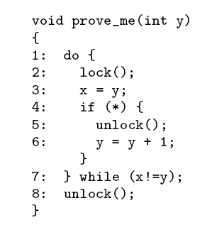
Example
Input:
Program P
Property ψ
Construct initial abstraction
Construct random tests
Test succeeded?
yes
Bug!
no
Abstractionsucceeded?
yes
Proof!
no
τ = error path in abstraction
f = frontier of error path
Can extend test beyond frontier?
yes
no
Refine abstraction

Slide 107
Example
0
×
Input:
Program P
Property ψ
1
×
×
y = 1
Construct initial abstraction
Construct random tests
2
×
×
3
Test succeeded?
yes
×
×
Bug!
no
4
Abstractionsucceeded?
yes
Proof!
×
×
no
5
7
τ = error path in abstraction
f = frontier of error path
×
×
×
Can extend test beyond frontier?
6
8
×
×
yes
no
τ=(0,1,2,3,4,7,8,9)
Refine abstraction
9
Symbolic execution +
Theorem proving
frontier
10
×

Slide 108
Symbolic execution + Theorem Proving
symbolic memory
y | y₀
lock.state | L
x | y₀
constraints
(x =y) = (y₀ = y₀ ) = T
(lock.state != L) = (L != L) = F
τ=(0,1,2,3,4,7,8,9)

Slide 109
Example
0
Input:
Program P
Property ψ
×
1
Construct initial abstraction
Construct random tests
×
×
2
×
×
Test succeeded?
yes
Bug!
3
no
×
×
Abstractionsucceeded?
yes
Proof!
4
no
×
×
τ = error path in abstraction
f = frontier of error path
5
7
Can extend test beyond frontier?
×
×
×
yes
6
8
no
×
×
Refine abstraction
9
Symbolic execution +
Theorem proving
frontier
10
×

Slide 110
Template-based refinement
0
×
1
×
×
8
8:¬ρ
8:ρ
2
×
×
×
×
9
9
3
×
×
ρ= (lock.state != L)
4
×
×
5
7
×
×
×
6
8
×
×
9
10
×

Slide 111
Template-based refinement
0
×
1
×
×
8
8:¬ρ
8:ρ
2
×
×
×
×
9
9
3
×
×
ρ= (lock.state != L)
4
×
×
5
7
×
×
×
6
8 :¬ρ
8:ρ
×
×
9
10
×

Slide 112
Example
0
×
Input:
Program P
Property ψ
1
×
×
Construct initial abstraction
Construct random tests
2
×
×
Test succeeded?
yes
Bug!
3
×
×
no
Abstractionsucceeded?
yes
Proof!
4
×
×
no
τ = error path in abstraction
f = frontier of error path
5
7
×
×
×
Can extend test beyond frontier?
yes
6
8 :¬ρ
8:ρ
×
×
no
Refine abstraction
frontier
9
τ=(0,1,2,3,4,7,<8,p>,9)
10
×

Slide 113
Proof!
0
×
Input:
Program P
Property ψ
1
×
×
Construct initial abstraction
Construct random tests
2
×
×
3
Test succeeded?
yes
×
×
Bug!
4⋀¬s
4⋀s
no
×
×
Abstractionsucceeded?
yes
Proof!
5⋀¬s
5⋀s
no
×
τ = error path in abstraction
f = frontier of error path
6⋀¬r
6⋀r
Correct, the program is
×
Can extend test beyond frontier?
yes
7⋀¬q
7⋀q
×
no
×
Refine abstraction
8⋀p
8⋀¬p
×
9
10

Slide 114
Yogi's solver interface
Representation
L
program locations.
R ⊆ L × L
Control flow graph
State: L → Formula –set
Symbolic state: each location has set of disjoint formulas
Theorem proving needs
Facts about pointers:
*&x = x
Subsumption checks:
ϕ ⇒ WP(l, ψ )
ϕ ⇒ ¬WP(l, ψ )
Structure sharing
Similar formulas in different states
Simplification
Collapse/Reduce formulas

Slide 115
Better Bug Reporting with
Better Privacy
Miguel Castro, Manuel Costa, Jean-Philippe Martin
ASPLOS 08
See also: Vigilante – Internet Worm Containment
Miguel Castro, Manuel Costa, Lintao Zhang

Slide 116
Replay Execution
Extract Path Condition
Solve Path Condition
(with Z3)
Compute Bits Revealed
teddybear
00102220344011100

Slide 117
Finding the buffer overflow
R | A | N | D | O | M | \n | \n | \n
:assumption (= b0 bv71[8])
:assumption (= b1 bv69[8])
:assumption (= b2 bv84[8])
:assumption (= b3 bv32[8]))
G | E | T | ‘ ‘ | O | M | \n | \n | \n
:assumption (distinct b6 bv10[8] bv32[8])
G | E | T | ‘ ‘ | O | M | . | . | .
Privacy: measure distance between original crash input and new input

Slide 118
Program Termination
Byron Cook
http://www.foment.net/byron/fsharp.shtml
A complete method for the synthesis of linear ranking functions. Podelski & Rybalchenkoy; VMCAI 04

Slide 119
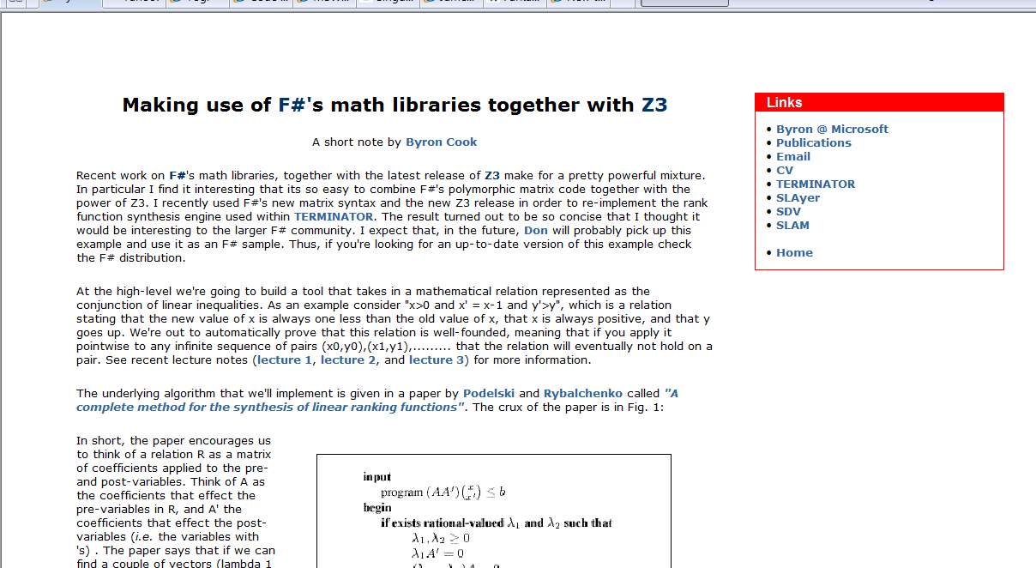
Form Byron Cook's blog

Slide 120
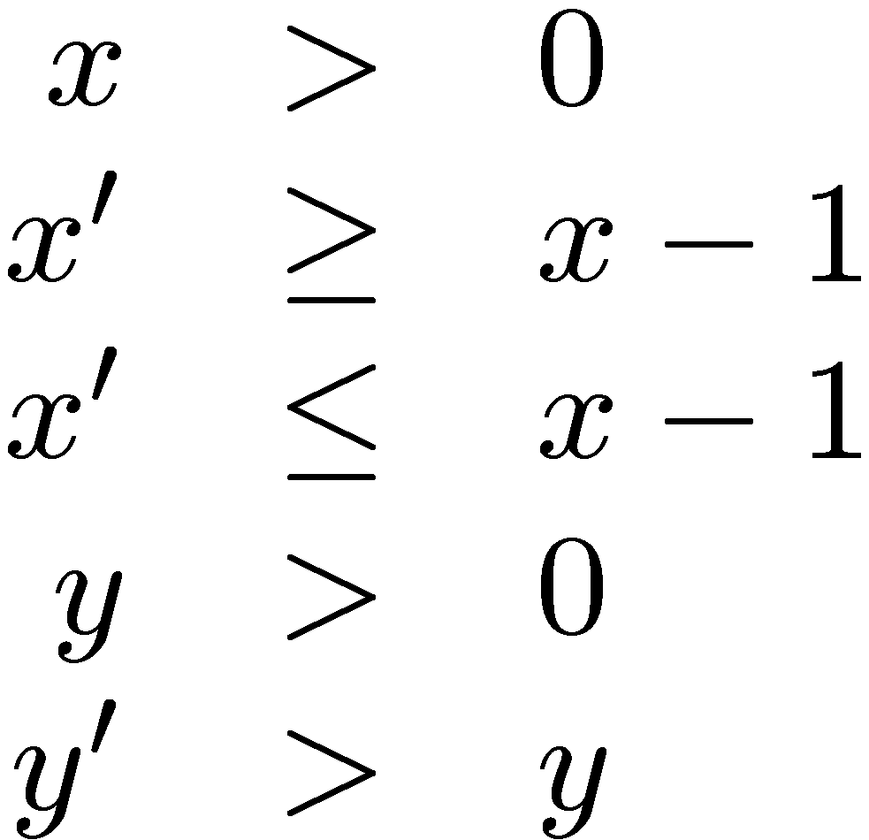
Does this program Terminate?

Slide 121
Rank function synthesis
Can we find f, b,
such that the
inclusion holds?
That is:

Slide 122
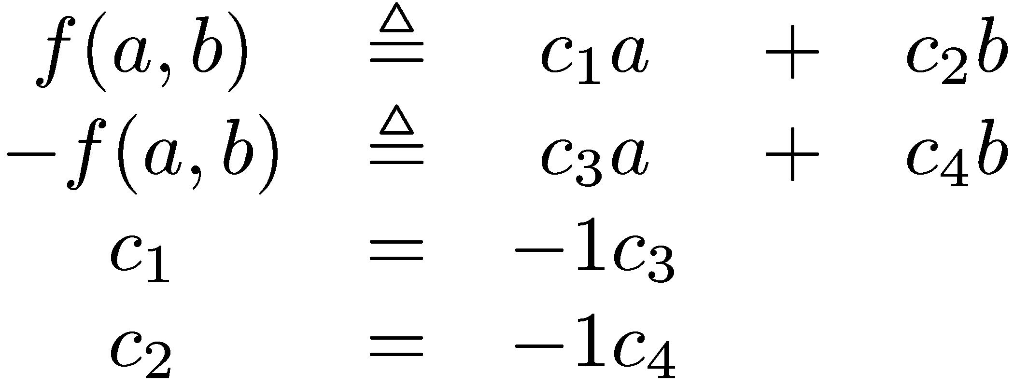
Rank function synthesis
Search over linear templates:

Slide 123
Rank function synthesis
Find
Search over linear templates:

Slide 124
Rank function synthesis
Search over linear templates:

Slide 125
Rank function synthesis – simplified version
Search over linear templates:

Slide 126
Rank function synthesis

Slide 127
Rank function synthesis
Instead solve:

Slide 128
Rank function synthesis
Instead solve:
Solver: Dual Simplex for Th(LRA).
See Byron Cook’s blog for an F#
program that produces input to Z3

Slide 129
Program Analysis as Constraint Solving
Sumit Gulwani, Saurabh Srivastava, Ramarathnam Venkatesan, PLDI 2008

Slide 130
Loop invariants
Θ
while (c) {
S
}
Post
How to find loop invariant I ?

Slide 131
Loop invariants
Assume I is of the form ∑_{j} a_{j}x_{j} ≤ b
Simplified problem:

Slide 132
Loop invariants ⇒ Existential
Original:
Relaxed:
Farkas’:
Existential: Problem: contains multiplication

Slide 133
Loop invariants ⇒ SMT solving
Original:
Existential:
Bounded:
Or: Bit-vectors:

Slide 134
Program Verification: Example
x := 0; y := 0;
while (x < 100)
x := x+n;
y := y+m;
{n=1 ∧ m=1} {y ≥ 100}
Invariant Template Satisfying Solution Loop Invariant
a₀ + a₁x + a₂y + a₃n + a₄m ≥ 0
b₀ + b₁x + b₂y + b₃n + b₄m ≥ 0
c₀ + c₁x + c₂y + c₃n + c₄m ≥ 0
a₂=b₀=c₄=1, a₁=b₃=c₀=-1
y ≥ x
m ≥ 1
n ≥ 1
a₀ + a₁x + a₂y + a₃n + a₄m ≥ 0
b₀ + b₁x + b₂y + b₃n + b₄m ≥ 0
a₂=b₂=1, a₁=b₁=-1
y ≥ x
m ≥ n
Invalid triple or Imprecise Template
a₀ + a₁x + a₂y + a₃n + a₄m ≥ 0
UNSAT

Slide 135
Digression: Bit-vectors and Z3
Bit-vector multiplication
For each sub-term A*B
Replace by fresh vector OUT
Create circuit for: OUT = A*B
Convert circuit into clauses: For each internal gate
Create fresh propositional variable
Represent gate as clause
{Out[0], ~A[0],~B[0]}, {A[0],~Out[0]}, {B[0],~Out[0]}, …..

Slide 136
Digression: Bit-vectors and Z3
Tableau + DPLL = Relevancy Propagation
Tableau goes outside in, DPLL inside out
Relevancy propagation: If DPLL sets θ:ψ∨ϕ to true, θ is marked as relevant, then first of ψ, ϕ to be set to true gets marked as relevant.
Used for circuit gates and for quantifier matching

Slide 137
Abstract Interpretation
and modular arithmetic
See Blog by Ruzica Piskac,
http://icwww.epfl.ch/~piskac/fsharp/
Material based on:
King & Søndergård, CAV 08
Muller-Olm & Seidl, ESOP 2005

Slide 138
Programs as transition systems
Transition system:
⟨
L locations, V variables, S = [V → Val] states, R ⊆ L × S × S × L transitions, Θ ⊆ S initial states
ℓ_{init} ∈ L initial location ⟩

Slide 139
Abstract abstraction
Concrete reachable states: CR: L → ℘(S)
Abstract reachable states: AR: L → A
Connections:
⊔ : A × A → A
γ : A → ℘(S) α : S → A α : ℘(S) → A where α(S) = ⊔ {α(s) | s ∈ S }

Slide 140
Abstract abstraction
Concrete reachable states: CR ℓ x ← Θ x ∧ ℓ = ℓ_{init}
CR ℓ x ← CR ℓ₀ x₀ ∧ R ℓ₀ x₀ x ℓ
Abstract reachable states:
AR ℓ x ← α(Θ(x)) ∧ ℓ = ℓ_{init}
AR ℓ x ← α(γ(AR ℓ₀ x₀) ∧ R ℓ₀ x₀ x ℓ)
Why? fewer (finite) abstract states

Slide 141
Abstraction using SMT
Abstract reachable states:
AR ℓ_{init} ← α(Θ)
Find interpretation M: M ⊨ γ(AR ℓ₀ x₀) ∧ R ℓ₀ x₀ x ℓ ∧ ¬γ(AR ℓ x)
Then:
AR ℓ ← AR ℓ ⊔ α(x^{M})

Slide 142
Abstraction: Linear congruences
States are linear congruences: A V = b mod 2^{m}
V is set of program variables.
A matrix, b vector of coefficients [0.. 2^{m}-1]

Slide 143
Example
When at ℓ₂ :
y is 0.
c contains number of bits in x.
ℓ₀: y ←x; c ←0; ℓ₁: while y != 0 do [ y ←y&(y-1); c ← c+1 ]
ℓ₂:

Slide 144
Abstraction: Linear congruences
States are linear congruences:
As Bit-vector constraints (SMTish syntax):
(and (= (bvadd (bvmul 010 x₀) (bvmul 011 x₁)) 001) (= (bvadd x₀ x₁) 011) )

Slide 145
Abstraction: Linear congruences
(A V = b mod 2^{m} ) ⊔ (A’ V = b’ mod 2^{m})
Combine:
Triangulate (Muller-Olm & Seidl)
Project on x

Slide 146
Bounded Model Checking of
Model Programs
Margus Veanes
FORTE 08

Slide 147
Goal:Model Based Development
Integration with symbolic analysis techniques at design time – smart model debugging
Theorem proving
Model checking
Compositional reasoning
Domain specific front ends
Different subareas require different adaptations
Model programs provide the common framework
Motivating example
SMB2 Protocol Specification
Sweet spot for model-based testing and verification.
Sample protocol document for
SMB2 (a network file protocol)
% pages
Adapter for testing
Scenarios (slicing)
Behavioral modeling
Scenarios (slicing)

Slide 148
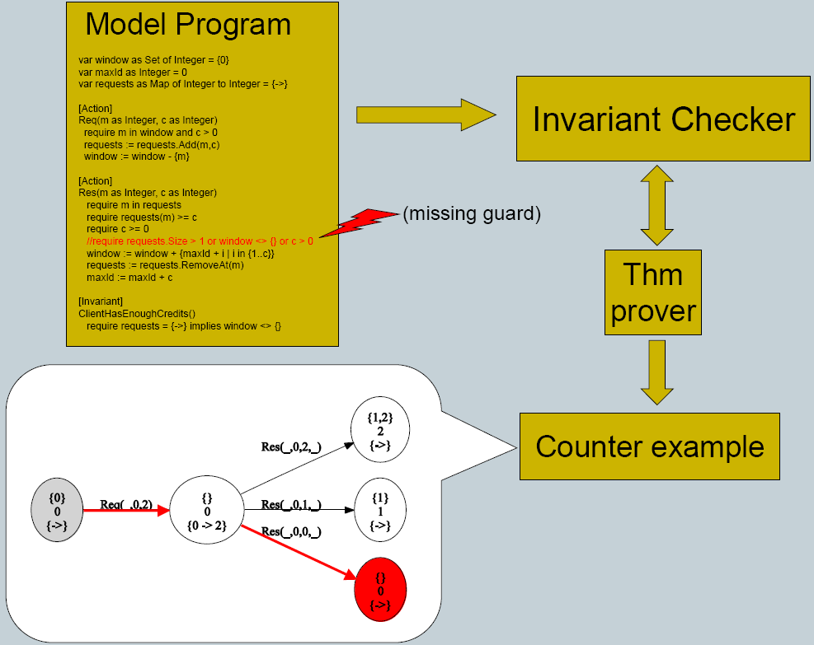
Symbolic Reachability

Slide 149
Bounded-reachability formula
Given a model program P step bound k and reachability condition φ

Slide 150
Array model programs and quantifier elimination
Array model programs use only maps with integer domain sort.
For normalizable comprehensions universal quantifiers can be eliminated using a decision procedure for the array property fragment [Bradley et. al, VMCAI 06]

Slide 151
Implementation using the SMT solver Z3
Set comprehensions are introduced through skolem constant definitions using support for quantifiers in Z3
Elimination of quantifiers is partial.
Model is refined if a spurious model is found by Z3.
A spurious model may be generated by Z3 if an incomplete heuristic is used during quantifier elimination.

Slide 152
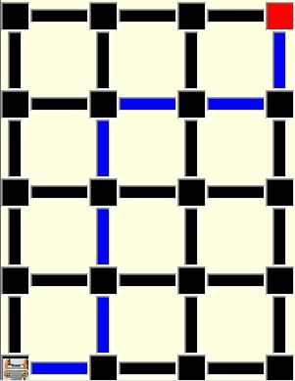
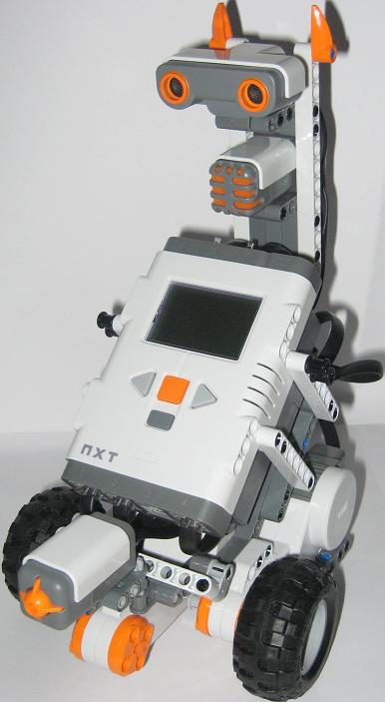
A different example: Adaptive Planning with Finite Horizon Lookahead
Model program:
Finish
Plan
Start

Slide 153
Verifying Garbage Collectors
- Automatically and fast
Chris Hawblitzel
http://www.codeplex.com/singularity/SourceControl/DirectoryView.aspx?SourcePath=%24%2fsingularity%2fbase%2fKernel%2fBartok%2fVerifiedGCs&changeSetId=14518

Slide 154
Context
Singularity
Safe micro-kernel
95% written in C#
all services and drivers in processes
Software isolated processes (SIPs)
all user code is verifiably safe
some unsafe code in trusted runtime
processes and kernel sealed at execution
Communication via channels
channel behavior is specified and checked
fast and efficient communication
Working research prototype
not Windows replacement
shared source download
Bartok
MSIL → X86 Compiler
BoogiePL
Procedural low-level language
Contracts
Verification condition generator
Garbage Collectors
Mark&Sweep
Copying GC
Verify small garbage collectors
more automated than interactive provers
borrow ideas from type systems for regions

Slide 155
Goal: safely run untrusted code
MSIL
MSIL: MSFT Intermediary Language
untrusted
code
compiler
typed x86
I/O
exception
handling
garbage
collector
trusted computing
base
(minimize this!)
linker, loader
safety verifier

Slide 156
Mark-sweep and copying collectors
abstract
graph
A
(root)
B
C
mark-sweep
copying from
copying to
A
A
A
C
C
B
B
B

Slide 157
Garbage collector properties
safety: gc does no harm
type safety
gc turns well-typed heap into well-typed heap
graph isomorphism
concrete graph represents abstract graph
effectiveness
after gc, unreachable objects reclaimed
termination
efficiency
verified
not
verified

Slide 158
Proving safety
abstract
graph
$AbsMem
A
(root)
B
C
$toAbs
$toAbs
concrete
graph
Mem
A
B
procedure GarbageCollectMs()
requires MsMutatorInv(root, Color, $toAbs, $AbsMem, Mem);
modifies Mem, Color, $toAbs;
ensures MsMutatorInv(root, Color, $toAbs, $AbsMem, Mem);
{
call Mark(root);
call Sweep();
}
function MsMutatorInv(...) returns (bool) {
WellFormed($toAbs) && memAddr(root) && $toAbs[root] != NO_ABS
&& (forall i:int::{memAddr(i)} memAddr(i) ==> ObjInv(i, $toAbs, $AbsMem, Mem))
&& (forall i:int::{memAddr(i)} memAddr(i) ==> White(Color[i]))
&& (forall i:int::{memAddr(i)} memAddr(i) ==> ($toAbs[i]==NO_ABS <==> Unalloc(Color[i])))}
function ObjInv(...) returns (bool) { memAddr(i) && $toAbs[i] != NO_ABS ==>
... $toAbs[Mem[i, field1]] != NO_ABS ...
... $toAbs[Mem[i, field1]] == $AbsMem[$toAbs[i], field1] ... }

Slide 159
Controlling quantifier instantiation
Idea: use marker
Relativize quantifiers using marker
function{:expand false} T(i:int) returns (bool) { true }
function GcInv(Color:[int]int, $toAbs:[int]int, $AbsMem:[int,int]int, Mem:[int,int]int) returns (bool) {
WellFormed($toAbs)
&& (forall i:int::{T(i)} T(i) ==> memAddr(i) ==>
ObjInv(i, $toAbs, $AbsMem, Mem)
&& 0 <= Color[i] && Color[i] < 4
&& (Black(Color[i]) ==> !White(Color[Mem[i,0]]) && !White(Color[Mem[i,1]]))
&& ($toAbs[i] == NO_ABS <==> Unalloc(Color[i])))
}

Slide 160
Controlling quantifier instantiation
Insert markers to enable triggers
procedure Mark(ptr:int)
requires GcInv(Color, $toAbs, $AbsMem, Mem);
requires memAddr(ptr) && T(ptr);
requires $toAbs[ptr] != NO_ABS;
modifies Color;
ensures GcInv(Color, $toAbs, $AbsMem, Mem);
ensures (forall i:int::{T(i)} T(i) ==> !Black(Color[i]) ==> Color[i] == old(Color)[i]);
ensures !White(Color[ptr]);
{
if (White(Color[ptr])) {
Color[ptr] := 2; // make gray
call Mark(Mem[ptr,0]);
call Mark(Mem[ptr,1]);
Color[ptr] := 3; // make black
}
}

Slide 161
Refinement Types for
Secure Implementations
http://research.microsoft.com/F₇
Jesper Bengtson,
Karthikeyan Bhargavan,
Cédric Fournet,
Andrew D. Gordon,
Sergio Maffeis
CSF 2008

Slide 162
Verifying protocol reference implementations
Executable code has more details than models
Executable code has better tool support: types, compilers, testing, debuggers, libraries, verification
Using dependent types: integrate cryptographic protocol verification as a part of program verification
Such predicates can also represent security-related concepts like roles, permissions, events, compromises, access rights,...

Slide 163
Example: access control for files
Un-trusted code may call a trusted library
Trusted code expresses security policy with assumes and asserts
Each policy violation causes an assertion failure
F₇ statically prevents any assertion failures by typing
type facts = CanRead of string | CanWrite of string
let read file = assert(CanRead(file)); …
let delete file = assert(CanWrite(file); …
let pwd = “C:/etc/passwd””
let tmp = “C:/temp/temp”
assume CanWrite(tmp)
assume ∀x . CanWrite(x) →CanRead(x)
let untrusted() =
let v1 = read tmp in // ok
let v2 = read pwd in //CanRead(pwd)
// assertion fails

Slide 164
Access control with refinement types
val read: file:string{CanRead(file)} → string
val delete: file:string{CanDelete(file)} → unit
val publish: file:string → unit{Public(file)}
Pre-conditions express access control requirements
Post-conditions express results of validation
F₇ type checks partially trusted code to guarantee that all preconditions (and hence all asserts) hold at runtime

Slide 165
Models for Domain Specific Languages with FORMULA & BAM
Ethan Jackson
FORTE 08

Slide 166
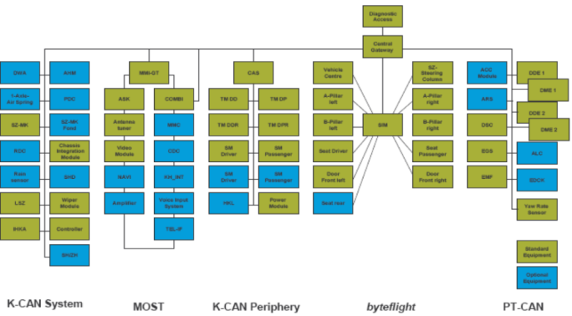
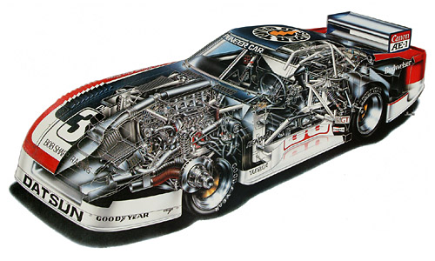
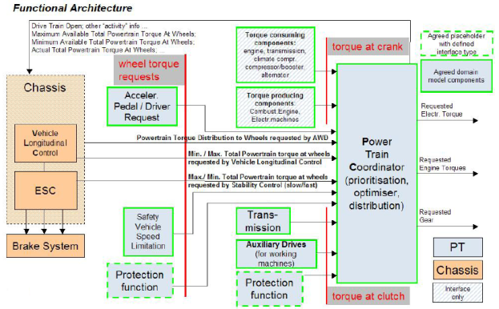
Designing Complex Systems Requires Multiple Abstractions
Automotive system is just processors and their communication buses
BMW architecture:
Taken from
A General Synthesis Approach for Embedded Systems Design with Applications to Multi-media and Automotive Designs.
Sangiovanni-Vincentelli et al., 2007.
More Abstract
Forget about the network; think about the software components
Product lines abstract across families of implementations
Functional architecture taken from AUTOSAR:
http://www.autosar.org
Screenshot of “Build Your Scion”:
http://www.scion.org

Slide 167
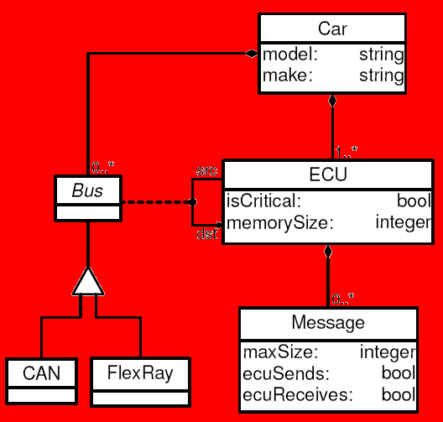
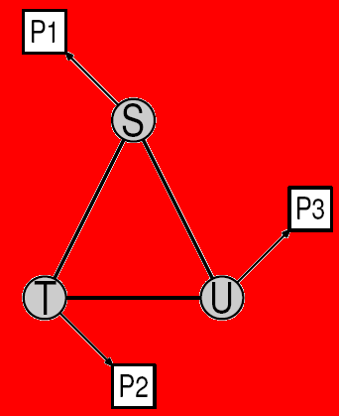
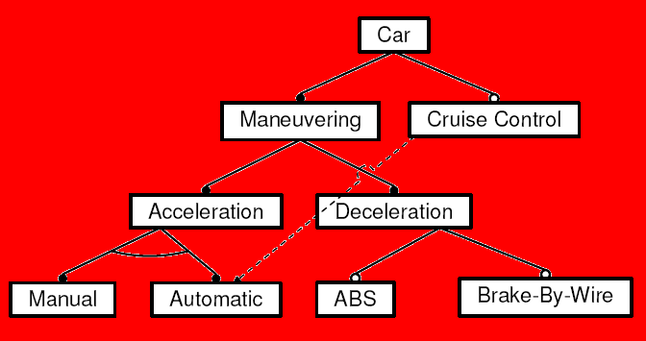
Many Modeling Styles are Used to Build Abstractions
Abstraction: ECU/Bus
Style: Domain-specific Language
Abstraction:
Scheduling Problem
Style:
Platform-based design
Abstraction:
Automotive Product-line
Style: Feature Diagram
Instance
Instance
Instance

Slide 168
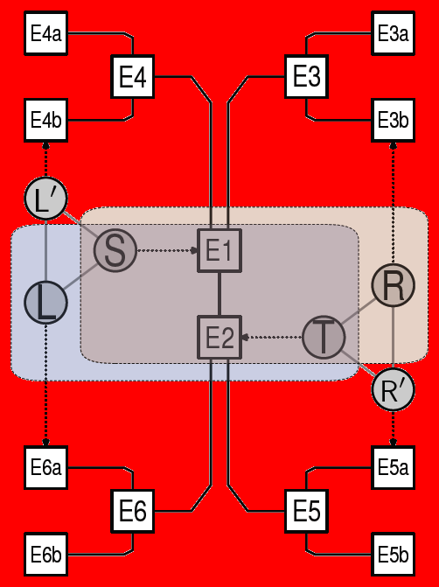
A Notorious Problem: How Do We Compose Abstractions?
We view each abstraction as providing (among other things) a constraint system representing the legal “models” of the abstraction. Composition occurs via these constraint systems:
Instance of scheduling problem
Instance of ECU/Bus rich syntax
Instance of feature description
Integration of Multiple Abstractions
For example, this instance must satisfy the constraints of each abstraction used in its construction.

Slide 169
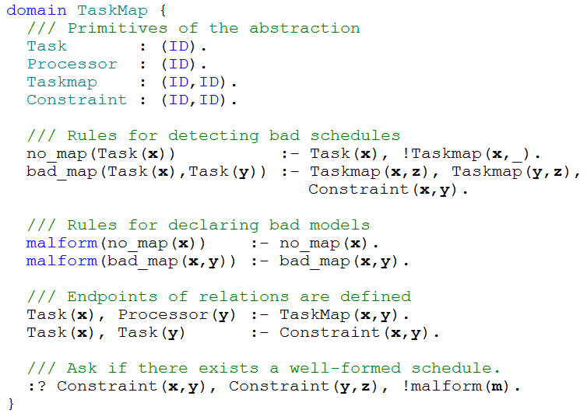
FORMULA is a CLP Language for Specifying, Composing, and Analyzing Abstractions
A domain encapsulates a reusable, composable constraint system
Special function symbols (malform, wellform) capture legal instances in a domain-independent way.
FORMULA can construct satisfying instances to logic program queries using Z3.

Slide 170
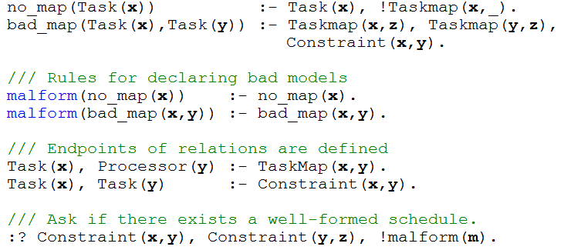
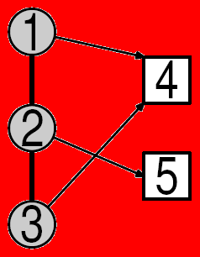
Search for satisfying instances are Reduced to Z3
This model finding procedure allows us to:
Determine if a composition of abstractions contains inconsistencies
Construct (partial) architectures that satisfy many domain constraints.
Generate design spaces of architectural invariants.
Reduction to Z3 works as follows:
6
5
S =
4
3
S
2
1
Q
Symbolic backwards chaining yields a set of candidate terms S with the following property:
A finite instance exists that satisfies the query Q iff some subset of S satisfies the query Q.
Once the finite set S is calculated, then S + Q is reduced to SMT and evaluated by Z3.

Slide 171
Selected Background
on SMT

Slide 172
Basics
Pre-requisites and notation

Slide 173
Language of logic - summary
Functions , Variables, Predicates
f, g, x, y, z, P, Q, =
Atomic formulas, Literals
P(x,f(y)), ¬Q(y,z)
Quantifier free formulas
P(f(a), b) ∧ c = g(d)
Formulas, sentences
∀x . ∀y . [ P(x, f(x)) ∨ g(y,x) = h(y) ]

Slide 174
Language: Signatures
A signature Σ is a finite set of:
Function symbols:
Σ_{F} = { f, g, … }
Predicate symbols:
Σ_{P} = { P, Q,=, true, false, … }
And an arity function: Σ → N
Function symbols with arity 0 are constants
A countable set V of variables
disjoint from Σ

Slide 175
Language: Terms
The set of terms T(Σ_{F} ,V) is the smallest set formed by the syntax rules:
t ∈ T ::= v v ∈ V
| f(t₁, …, t_{n}) f ∈ Σ_{F} t₁, …, t_{n} ∈ T
Ground terms are given by T(Σ_{F} ,∅)

Slide 176
Language: Atomic Formulas
a ∈ Atoms ::= P(t₁, …, t_{n})
P ∈ Σ_{P} t₁, …, t_{n} ∈ T
An atom is ground if t₁, …, t_{n} ∈ T(Σ_{F} ,∅)
Literals are (negated) atoms:
l ∈ Literals ::= a | ¬ a a ∈ Atoms

Slide 177
Language: Quantifier free formulas
The set QFF(Σ,V) of quantifier free formulas is the smallest set such that:
ϕ ∈QFF ::= a ∈ Atoms atoms
| ¬ ϕ negations
| ϕ ↔ ϕ’ bi-implications
| ϕ ∧ ϕ’ conjunction
| ϕ ∨ ϕ’ disjunction
| ϕ → ϕ’ implication

Slide 178
Language: Formulas
The set of first-order formulas are obtained by adding the formation rules:
ϕ ::= …
| ∀ x . ϕ universal quant.
| ∃ x . ϕ existential quant.
Free (occurrences) of variables in a formula are theose not bound by a quantifier.
A sentence is a first-order formula with no free variables.

Slide 179
Theories
A (first-order) theory T (over signature Σ) is a set of (deductively closed) sentenes (over Σ and V)
Let DC(Γ) be the deductive closure of a set of sentences Γ.
For every theory T, DC(T) = T
A theory T is constistent if false ∉ T
We can view a (first-order) theory T as the class of all models of T (due to completeness of first-order logic).

Slide 180
Models (Semantics)
A model M is defined as:
Domain S; set of elements.
Interpretation, f^{M} : S^{n} →S for each f ∈ Σ_{F} with arity(f) = n
Interpretation P^{M} ⊆ S^{n} for each P ∈ Σ_{P} with arity(P) = n
Assignment x^{M} ∈ S for every variable x ∈ V
A formula ϕ is true in a model M if it evaluates to true under the given interpretations over the domain S.
M is a model for the theory T if all sentences of T are true in M.

Slide 181
T-Satisfiability
A formula ϕ(x) is T-satisfiable in a theory T if there is a model of DC(T ∪ ∃ x ϕ(x)). That is, there is a model M for T in which ϕ(x) evaluates to true.
Notation:
M ⊨_{T} ϕ(x)

Slide 182
T-Validity
A formula ϕ(x) is T-valid in a theory T if ∀ x ϕ(x) ∈ T. That is, ϕ(x) evaluates to true in every model M of T.
T-validity:
⊨_{T} ϕ(x)

Slide 183
Checking validity
Checking the validity of ϕ in a theory T:
ϕ is T-valid
≡ T-unsat: ¬ϕ
≡ T-unsat: ∀x∃y∀z∃u . φ (prenex of ¬ϕ)
≡ T-unsat: ∀x∀z . φ[f(x),g(x,z)] (skolemize)
⇐ T-unsat: φ[f(a₁),g(a₁,b₁)] ∧ … (instantiate) ∧ φ[f(a_{n}),g(a_{n},b_{n})] (⇒ if compactness)
≡ T-unsat: φ₁ ∨ … ∨ φ_{m} (DNF)
where each φ_{i} is a conjunction.

Slide 184
Checking Validity – the morale
Theory solvers must minimally be able to
check unsatisfiability of conjunctions of literals.

Slide 185
Clauses – CNF conversion
We want to only work with formulas in Conjunctive Normal Form CNF.
is not in CNF.

Slide 186
Clauses – CNF conversion
Equi-satisfiable CNF formula

Slide 187
Clauses – CNF conversion
cnf(ϕ) = let (q,F) = cnf’(ϕ ) in q ∧ F
cnf’(a) = (a, true)
cnf’(ϕ ∧ ϕ’) = let (q,F₁) = cnf’(ϕ) (r, F₂) = cnf’(ϕ’)
p = fresh Boolean variable in (p, F₁ ∧ F₂ ∧ (¬ p ∨ q ) ∧ (¬ p ∨ r) ∧ (¬ p ∨ ¬ q ∨ ¬ r))
Exercise: cnf’(ϕ ∨ ϕ’), cnf’(ϕ ↔ ϕ’), cnf’(¬ ϕ)

Slide 188
Clauses - CNF
Main properties of basic CNF
Result F is a set of clauses.
ϕ is T-satisfiable iff cnf(ϕ) is.
size(cnf(ϕ)) ≤ 4(size(ϕ))
ϕ ⇔ ∃ p_{aux} cnf(ϕ)

Slide 189
DPLL(∅)

Slide 190
DPLL - classique
Incrementally build a model M for a CNF formula F (set of clauses).
Initially M is the empty assignment
Propagate: M: M(r) ← false
if (p ∨¬q ∨¬r) ∈ F, M(p) = false, M(q) = true
Decide M(p) ← true or M(p) ← false,
if p is not assigned.
Backtrack:
if (p ∨¬q ∨¬r) ∈ F, M(p) = false, M(q) = M(r)= true, (e.g. M ⊨_{T} ¬C)

Slide 191
Modern DPLL – as transitions
Maintain states of the form:
M || F - during search
M || F || C – for backjumping
M a partial model, F are clauses, C is a clause.
Decide M || F ⇒ Ml^{d} || F if l ∈ F \ M
d is a decision marker
Propagate M || F ⇒ Ml^{C} || F
if l ∈ C ∈ F, C = (C’ ∨ l), M ⊨_{T} ¬C’

Slide 192
Modern DPLL – as transitions
Conflict M || F ⇒ M || F || C if C ∈ F, M ⊨_{T} ¬C
Learn M || F || C ⇒ M || F, C || C i.e, add C to F
Resolve Mp^{(C’ ∨p)} || F || C ∨ ¬p ⇒ M || F || C ∨ C’
Skip Mp || F || C ⇒ M || F || C if ¬l∉C
Backjump MM’l^{d}|| F || C ⇒ M¬l^{C} || F
if ¬l∈C and M’ does not intersect with ¬C

Slide 193
DPLL(E)

Slide 194
DPLL(E)
Congruence closure just checks satisfiability of conjunction of literals.
How does this fit together with Boolean search DPLL?
DPLL builds partial model M incrementally
Use M to build C*
After every Decision or Propagate, or
When F is propositionally satisfied by M.
Check that disequalities are satisfied.

Slide 195
E - conflicts
Recall Conflict:
Conflict M || F ⇒ M || F || C if C∈F, M ⊨_{T} ¬C
A version more useful for theories:
Conflict M || F ⇒ M || F || C if C⊆ ¬M, ⊨_{T} C

Slide 196
E - conflicts
Example
M = fff(a) = a, g(b) = c, fffff(a)= a, a ≠ f(a)
¬ C = fff(a) = a, fffff(a)=a, a ≠ f(a)
⊨_{E} fff(a)≠ a∨ fffff(a)≠ a ∨ a = f(a)
Use C as a conflict clause.

Slide 197
Linear
Arithmetic

Slide 198
Approaches to linear arithmetic
Fourier-Motzkin:
Quantifier elimination procedure
∃x (t ≤ ax ∧ t’ ≤ bx ∧ cx ≤ t’’) ⇔ ct ≤ at’∧ ct’ ≤ bt’’
Polynomial for difference logic.
Generally: exponential space, doubly exponential time.
Simplex:
Worst-case exponential, but
Time-tried practical efficiency.
Linear space

Slide 199
Combining Theory Solvers

Slide 200
Nelson-Oppen procedure
Initial state: L is set of literals over Σ₁ ∪ Σ₂
Purify: Preserving satisfiability, convert L into L’ = L₁ ∪ L₂ such that L₁ ∈ T(Σ₁,V), L₂ ∈ T(Σ₂,V) So L₁ ∩ L₂ = V_{shared} ⊆ V
Interaction: Guess a partition of V_{shared}
Express the partition as a conjunction of equalities. Example, { x₁ }, { x₂ , x₃ }, { x₄ } is represented as: ψ: x₁ ≠ x₂ ∧x₁ ≠ x₄ ∧x₂ ≠ x₄ ∧x₂ = x₃
Component Procedures: Use solver 1 to check satisfiability of L₁ ∧ ψ Use solver 2 to check satisfiability of L₂ ∧ ψ

Slide 201
NO – reduced guessing
Instead of guessing, we can often deduce the equalities to be shared.
Interaction: T₁ ∧ L₁ ⊨ x = y then add equality to ψ.
If theories are convex, then we can:
Deduce all equalities.
Assume every thing not deduced is distinct.
Complexity: O(n⁴ x T₁(n) x T₂(n)).

Slide 202
Model-based combination
Reduced guessing is only complete for convex theories.
Deducing all implied equalities may be expensive.
Example: Simplex – no direct way to extract from just bounds and β
But: backtracking is pretty cheap nowadays:
If β(x) = β(y), then x, y are equal in arithmetical component.

Slide 203
Model-based combination
Backjumping is cheap with modern DPLL:
If β(x) = β(y), then x, y are equal in arithmetical model.
So let’s add x = y to ψ, but allow to backtrack from guess.
In general: if M₁ is the current model
M₁ ⊨ x = y then add literal (x = y)^{d}

Slide 204
Arrays

Slide 205
Theory of arrays
Functions: Σ_{F} = { read, write }
Predicates: Σ_{P} = { = }
Convention a[i] means: read(a,i)
Non-extensional arrays T_{A}:
∀a, i, v . write(a,i,v)[i] = v
∀a, i, j, v . i ≠ j ⇒ write(a,i,v)[j] = a[j]
Extensional arrays: T_{EA} = T_{A} +
∀a, b. ((∀i. a[i] = b[i]) ⇒ a = b)

Slide 206
Decision procedures for arrays
Let L be literals over Σ_{F} = { read, write }
Find M such that: M ⊨_{TA} L
Basic algorithm, reduce to E:
for every sub-term read(a,i), write(b,j,v) in L
i ≠ j ∧ a = b ⇒ read(write(b,j,v),i) = read(a,i)
read(write(b,j,v),j) = v
Find M_{E}, such that M_{E} ⊨_{E} L ∧ AssertedAxioms

Slide 207
Quantifiers and E-graph matching

Slide 208
DPLL(QT) – cute quantifiers
We can use DPLL(T) for ϕ with quantifiers.
Treat quantified sub-formulas as atomic predicates.
In other words, if ∀x.ψ(x) is a sub-formula if ϕ, then introduce fresh p. Solve instead
ϕ[∀x.ψ(x) ← p]

Slide 209
DPLL(QT)
Suppose DPLL(T) sets p to false
⇒ any model M for ϕ must satisfy: M ⊨ ¬ ∀x.ψ(x)
⇒ for some sk_{x}: M ⊨ ¬ ψ(sk_{x})
In general: ⊨ ¬ p → ¬ ψ(sk_{x})

Slide 210
DPLL(QT)
Suppose DPLL(T) sets p to true
⇒ any model M for ϕ must satisfy: M ⊨ ∀x.ψ(x)
⇒ for every term t: M ⊨ ψ(t)
In general: ⊨ p → ψ(t) For every term t.

Slide 211
DPLL(QT)
Summary of auxiliary axioms:
⊨ ¬ p → ¬ ψ(sk_{x}) For fixed, fresh sk_{x}
⊨ p → ψ(t) For every term t.
Which terms t to use for auxiliary axioms of the second kind?

Slide 212
DPLL(QT) with E-matching
⊨ p → ψ(t) For every term t.
Approach:
Add patterns to quantifiers
Search for instantiations in E-graph. ∀a,i,v { write(a,i,v) } . read(write(a,i,v),i) = v

Slide 213
DPLL(QT) with E-matching
⊨ p → ψ(t) For every term t.
Approach:
Add patterns to quantifiers
Search for pattern matches in E-graph. ∀a,i,v { write(a,i,v) } . read(write(a,i,v),i) = v
Add equality every time there is a write(b,j,w) term in E.

Slide 214
Z3 -An Efficient
SMT Solver

Slide 215
Main features
Linear real and integer arithmetic.
Fixed-size bit-vectors
Uninterpreted functions
Extensional arrays
Quantifiers
Model generation
Several input formats (Simplify, SMT-LIB, Z3, Dimacs)
Extensive API (C/C++, .Net, OCaml)

Slide 216
Web

Slide 217
Supporting material
http://research.microsoft.com/projects/z3/documentation.html

Slide 218
Z3: Core System Components
Text
C
.NET
OCaml
Theories
Bit-Vectors
Rewriting Simplification
Arithmetic
Arrays
E-matching
Core Theory
Partial orders
Tuples
SAT solver

Slide 219
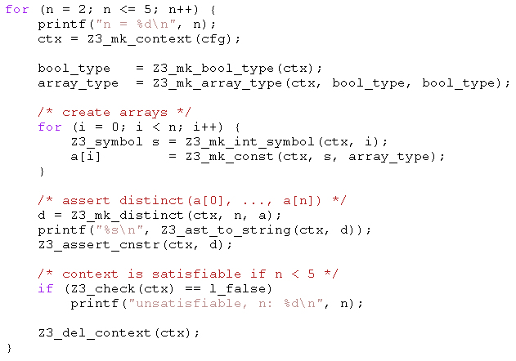
Example: C API
Given arrays:
bool a1[bool];
bool a2[bool];
bool a3[bool];
bool a4[bool];
All can be distinct.
Add:
bool a5[bool];
Two of a1,..,a5 must be equal.

Slide 220
Example: SMT-LIB
(benchmark integer-linear-arithmetic
:status sat
:logic QF_LIA
:extrafuns ((x1 Int) (x2 Int) (x3 Int) (x4 Int) (x5 Int))
:formula (and (>= (- x1 x2) 1)
(<= (- x1 x2) 3)
(= x1 (+ (* 2 x3) x5))
(= x3 x5)
(= x2 (* 6 x4)))
)
(benchmark array
:logic QF_AUFLIA
:status unsat
:extrafuns ((a Array) (b Array) (c Array))
:extrafuns ((i Int) (j Int))
:formula (and
(= (store a i v) b)
(= (store a j w) c)
(= (select b j) w)
(= (select c i) v)
(not (= b c))
)

Slide 221
SMT-LIB syntax – basics
benchmark ::= (benchmark name [:status (sat | unsat | unknown)] :logic logic-name declaration*)
declaration ::= :extrafuns (func-decl*) | :extrapreds (pred-decl*) | :extrasorts (sort-decl*) | :assumption fmla | :formula fmla
sort-decl ::= id - identifier
func-decl ::= id sort-decl* sort-decl - name of function, domain, range
pred-decl ::= id sort-decl* - name of predicate, domain
fmla ::= (and fmla*) | (or fmla*) | (not fmla) | (if_then_else fmla fmla fmla) | (= term term) | (implies fmla fmla) (iff fmla fmla) | (predicate term*)
Term ::= (ite fmla term term) | (id term*) - function application | id - constant

Slide 222
SMT-LIB syntax - basics
Logics:
QF_UF – Un-interpreted functions. Built-in sort U
QF_AUFLIA – Arrays and Integer linear arithmetic.
Built-in Sorts:
Int, Array (of Int to Int)
Built-in Predicates:
<=, >=, <, >,
Built-in Functions:
+, *, -, select, store.
Constants: 0, 1, 2, …

Slide 223
SMT-LIB – encodings
Q: There is no built-in function for max or min. How do I encode it?
(max x y) is the same as (ite (> x y) x y)
Also: replace (max x y) by fresh constant max_x_y add assumptions: :assumption (implies (> x y) (= max_x_y x)) :assumption (implies (<= x y) (= max_x_y y))
Q: Encode the predicate (even n), that is true when n is even.

Slide 224
Quantifiers
Quantified formulas in SMT-LIB:
fmla ::= … | (forall bound* fmla) | (exists bound* fmla)
Bound ::= ( id sort-id )
Q: I want f to be an injective function. Write an axiom that forces f to be injective.
Patterns: guiding the instantiation of quantifiers (Lecture 5)
fmla ::= … | (forall (?x A) (?y B) fmla :pat { term }) | (exists (?x A) (?y B) fmla :pat { term })
Q: what are the patterns for the injectivity axiom?

Slide 225
Using the Z3 (managed) API
open Microsoft.Z3
open System.Collections.Generic
open System
let par = new Config()
do par.SetParamValue("MODEL", "true")
let z3 = new TypeSafeContext(par)
Create a context z3:
let check (fmla) =
z3.Push();
z3.AssertCnstr(fmla);
(match z3.Check() with
| LBool.False -> Printf.printf "unsat\n"
| LBool.True -> Printf.printf "sat\n"
| LBool.Undef -> Printf.printf "unknown\n"
| _ -> assert false); z3.Pop(1ul)
Check a formula
Push
AssertCnstr
Check
Pop

Slide 226
Using the Z3 (managed) API
let (===) x y = z3.MkEq(x,y)
let (==>) x y = z3.MkImplies(x,y)
let (&&) x y = z3.MkAnd(x,y)
let neg x = z3.MkNot(x)
let a = z3.MkType(“a”)
let f_decl = z3.MkFuncDecl("f",a,a)
let x = z3.MkConst(“x”,a)
let f x = z3.MkApp(f_decl,x)
Declaring z3 shortcuts, constants and functions
Proving a theorem
let fmla1 = ((x === f(f(f(f(f(f x))))) && (x === f(f(f x)))) ==> (x === (f x))
do check (neg fmla1)
(benchmark euf :logic QF_UF :extrafuns ((f U U) (x U)) :formula (not (implies (and (= x (f(f(f(f(f x)))))) (= x (f(f(f x))))) (= x (f x))))
compared to

Slide 227
Enumerating models
We want to find models for
But we only care about different

Slide 228
Enumerating models
Representing the problem
void Test() {
Config par = new Config();
par.SetParamValue("MODEL", "true");
z3 = new TypeSafeContext(par);
intT = z3.MkIntType();
i1 = z3.MkConst("i1", intT); i2 = z3.MkConst("i2", intT);
i3 = z3.MkConst("i3", intT);
z3.AssertCnstr(Num(2) < i1 & i1 <= Num(5));
z3.AssertCnstr(Num(1) < i2 & i2 <= Num(7));
z3.AssertCnstr(Num(-1) < i3 & i3 <= Num(17));
z3.AssertCnstr(Num(0) <= i1 + i2 + i3 & Eq(i2 + i3, i1));
Enumerate();
par.Dispose();
z3.Dispose();
}

Slide 229
Enumerating models
Enumeration:
void Enumerate() {
TypeSafeModel model = null;
while (LBool.True == z3.CheckAndGetModel(ref model)) {
model.Display(Console.Out);
int v1 = model.GetNumeralValueInt(model.Eval(i1));
TermAst block = Eq(Num(v1),i1);
Console.WriteLine("Block {0}", block);
z3.AssertCnstr(!block);
model.Dispose();
}
}
TermAst Eq(TermAst t1, TermAst t2) { return z3.MkEq(t1,t2); }
TermAst Num(int i) { return z3.MkNumeral(i, intT); }

Slide 230
Push, Pop
int Maximize(TermAst a, int lo, int hi) {
while (lo < hi) {
int mid = (lo+hi)/2;
Console.WriteLine("lo: {0}, hi: {1}, mid: {2}",lo,hi,mid);
z3.Push();
z3.AssertCnstr(Num(mid+1) <= a & a <= Num(hi));
TypeSafeModel model = null;
if (LBool.True == z3.CheckAndGetModel(ref model)) {
lo = model.GetNumeralValueInt(model.Eval(a));
model.Dispose();
}
else hi = mid;
z3.Pop();
}
return hi;
}
Maximize(i3,-1,17):

Slide 231
Push, Pop – but reuse search
int Maximize(TermAst a, int lo, int hi) {
while (lo < hi) {
int mid = (lo+hi)/2;
Console.WriteLine("lo: {0}, hi: {1}, mid: {2}",lo,hi,mid);
z3.Push();
z3.AssertCnstr(Num(mid+1) <= a & a <= Num(hi));
TypeSafeModel model = null;
if (LBool.True == z3.CheckAndGetModel(ref model)) {
lo = model.GetNumeralValueInt(model.Eval(a));
model.Dispose();
lo = Maximize(a, lo, hi);
}
else hi = mid;
z3.Pop();
}
return hi;
}

