Slide 1
Introductions

Slide 2
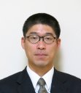
Mutsunori Banbara
Nagoya University

Slide 3
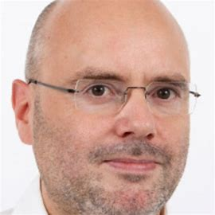
Armin Biere
Freiburg
Prof. Dr. Armin Biere (uni-freiburg.de)

Slide 4
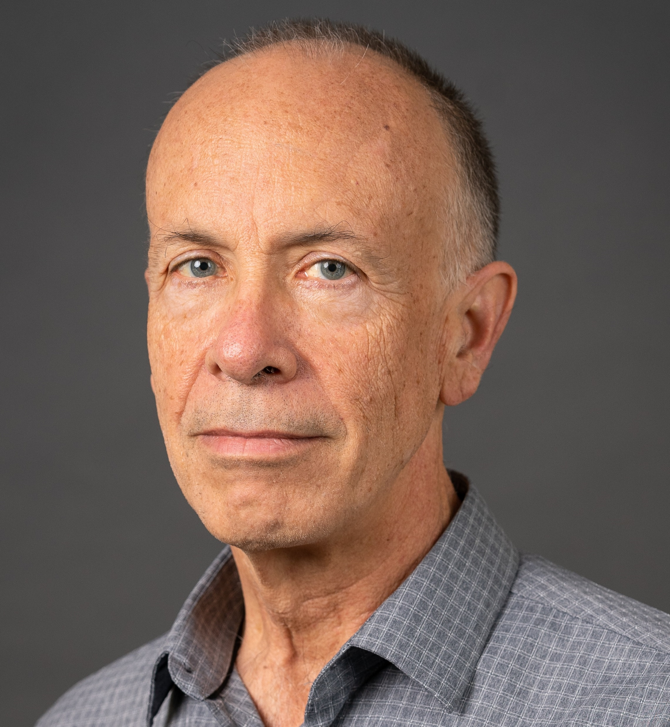
Sam Buss
University of California, San Diego Department of Mathematics
sbuss@ucsd.edu http:/math.ucsd.edu/~sbuss
Interests:
Mathematical logic, proof complexity, bounded arithmetic, SAT solvers and resolution, algorithms and complexity.
Recent research includes: DRAT proofs (with N. Thapen) Independence results for NEXP vs P/poly in Bounded Arithmetic (with A. Atserias and M. Müller) MaxSat (with ML Bonet, A. Ignjatiev, J. Marques-Silva, A. Morgado) OBDD proofs (with D. Itsykson, A. Knop, A. Riazanov, D. Sokolov) TFNP, Proof Systems and Monotone Circuits (with N. Fleming and R. Impagliazzo) Proof Systems for Branching Programs (with A. Das and A. Knop) Proof Complexity survey (Handbook of Proof Theory, with J. Nordstrom).

Slide 5
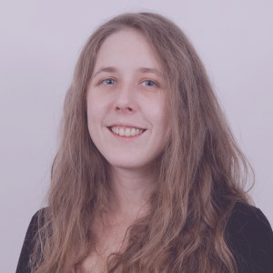
Katalin Fazekas
TU Wien
Katalin Fazekas - Homepage (kfazekas.github.io)

Slide 6
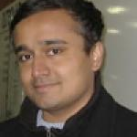
Vijay Ganesh
Georgia Tech
Vijay Ganesh | School of Computer Science (gatech.edu)

Slide 7
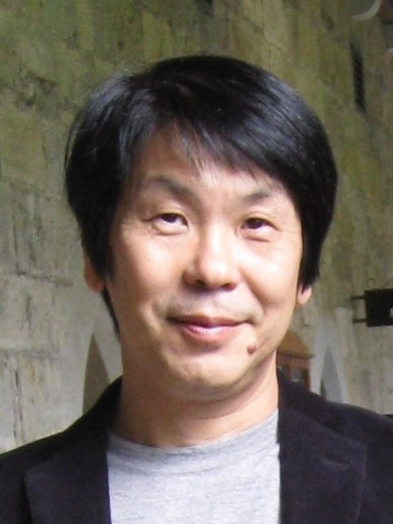
Katsumi Inoue
National institute of Informatics

Slide 8
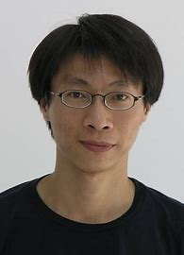
Jie-Hong Roland Jiang
National Taiwan University
Jie-Hong Roland Jiang (江介宏) @ National Taiwan University (ntu.edu.tw)

Slide 9
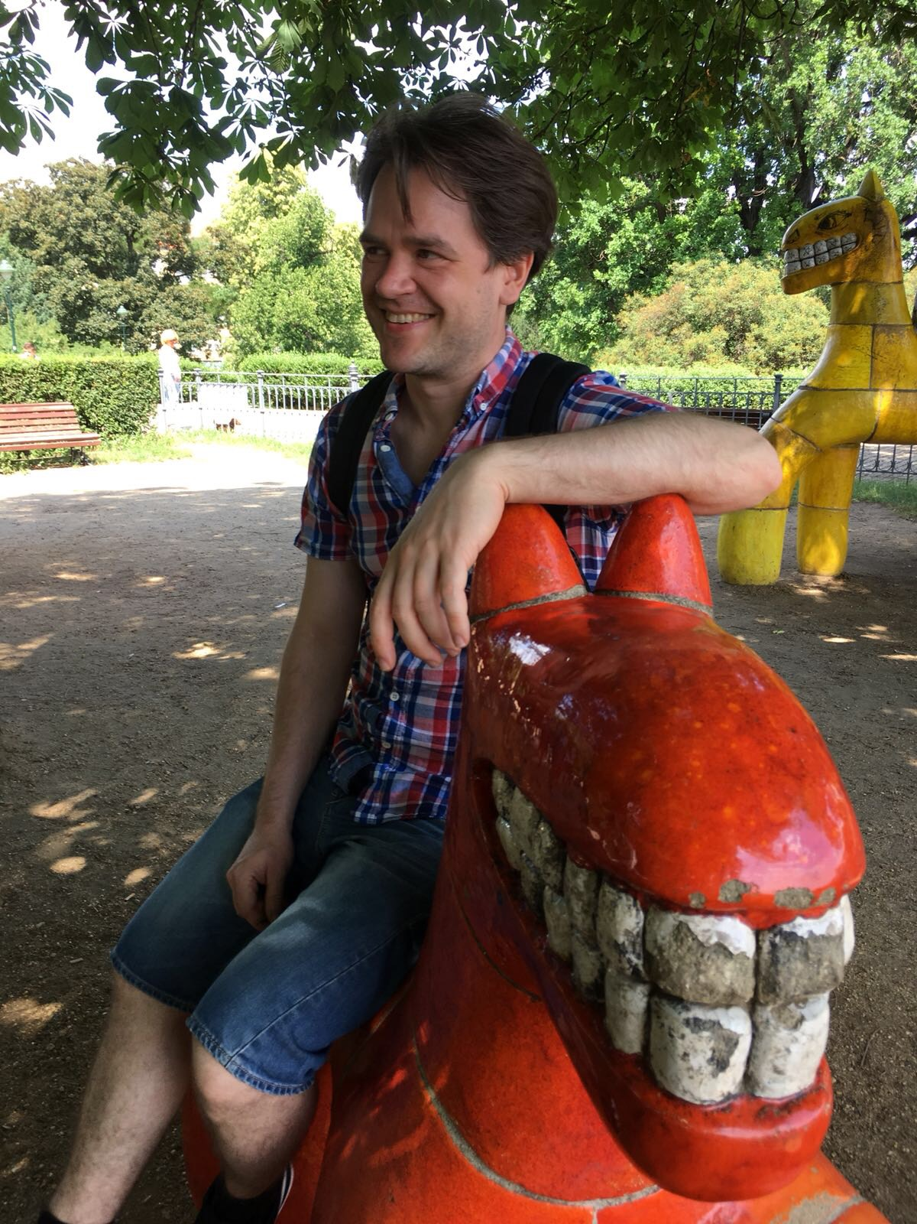
Matti Järvisalo
Helsinki
Matti Järvisalo (helsinki.fi)

Slide 10
Naoki Kobayashi
University of Tokyo
Kobayashi Laboratory (u-tokyo.ac.jp)

Slide 11
Miyuki Koshimura
Kyoshu University

Slide 12
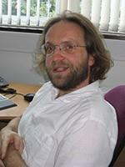
Oliver Kullmann
Swansea
Dr Oliver Kullmann - Swansea University

Slide 13
Shin-Ichi Minato
Kyoto University
Shin-ichi Minato's Home Page (kyoto-u.ac.jp)

Slide 14
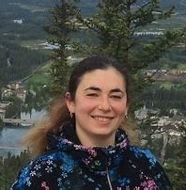
Nina Narodytska
VMWare
Nina Narodytska's website
VMware Research | Nina Narodytska

Slide 15
Aina Niemetz
Stanford
Aina Niemetz | Sr. Research Scientist, Computer ScienceStanford University

Slide 16
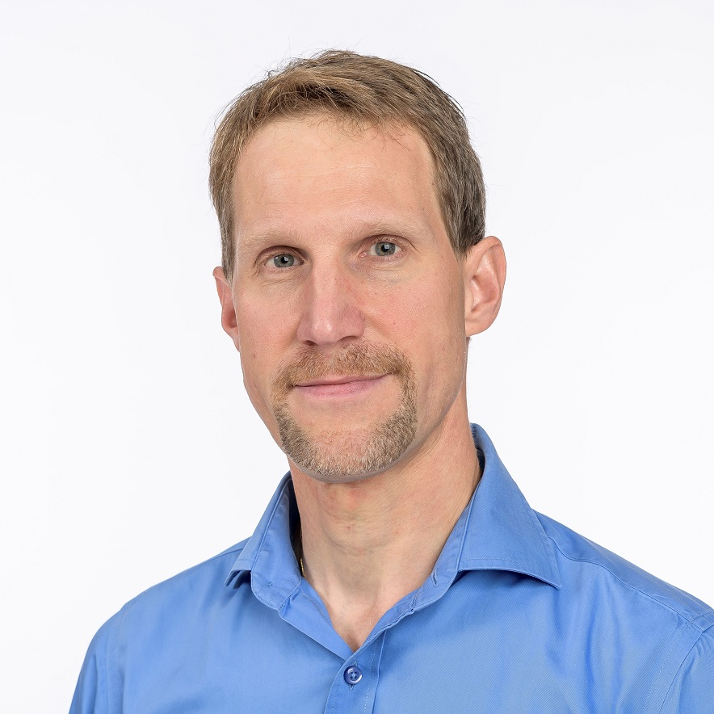
Jakob Nordström
DIKU
Jakob Nordström (jakobnordstrom.github.io)

Slide 17
Mathias Preiner
Stanford
Home | Mathias Preiner (stanford.edu)

Slide 18
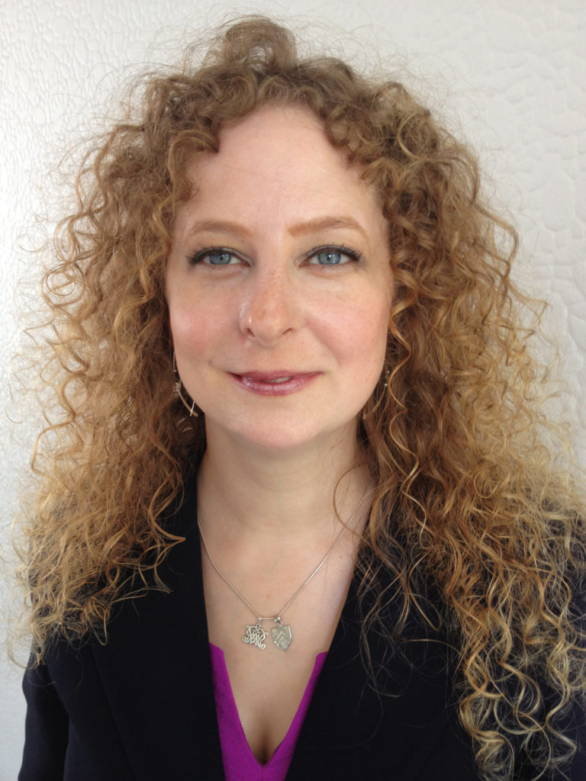
Kristin Rozier
Iowa State University
Kristin Yvonne Rozier, Ph.D. – Iowa State University (iastate.edu)

Slide 20
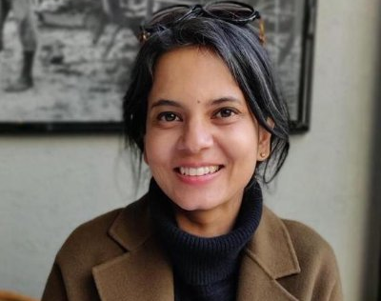
Roopsha Samanta
Roopsha Samanta (purdue.edu)

Slide 21
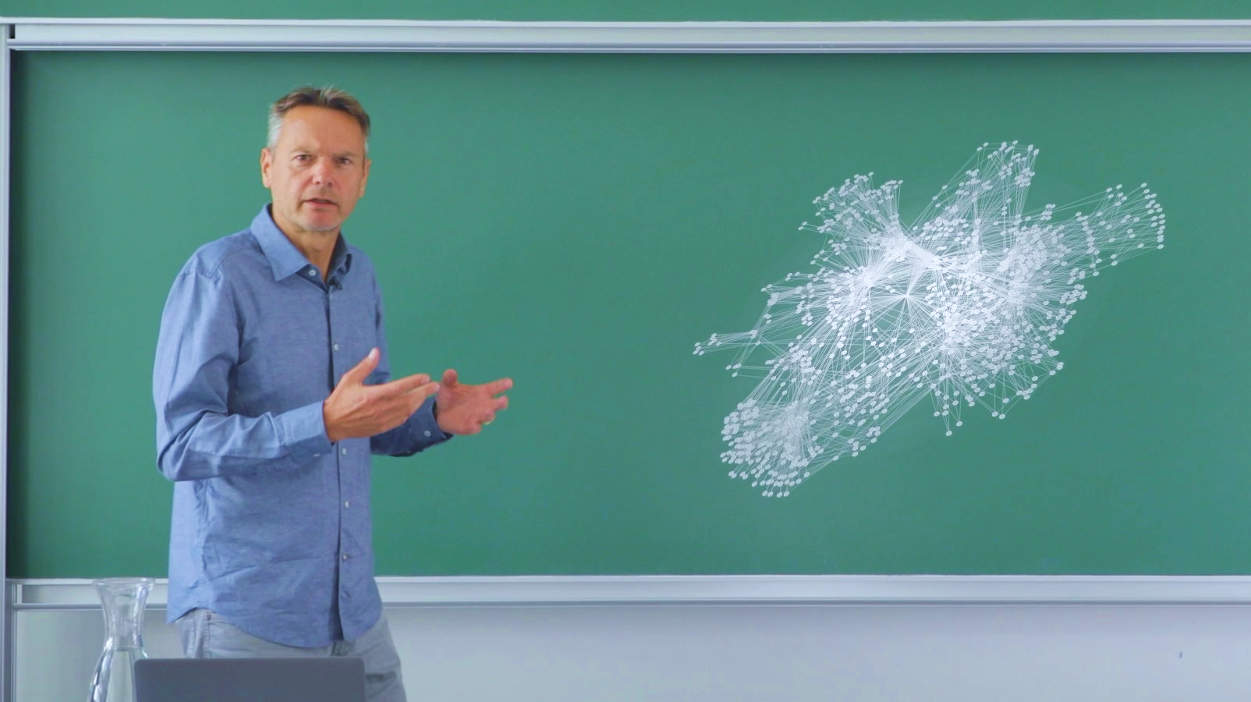
Stefan Szeider
TU Wien
ac.tuwien.ac.at/people/szeider/

Slide 22
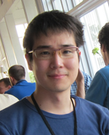
Soh Takehide
tsoh.org
Kobe University

Slide 24
Hiroshi Unno (University of Tsukuba, Japan)
Interested in generalizing verification/synthesis theories via PL theory, learning theory, and proof/model theories, and then building high-performance tools based on them
Constraint Satisfaction & Optimization
PCSat [AAAI20, CAV21dt, CAV21rel] for solving CHCs, SyGuS, and pfwCSP
Internally uses CEGIS, SMT, and MaxSAT
Ongoing extension inspired by CDCL
OptPCSat [SAS15, POPL23opt] for maximal/minimal CHC solving
MuVal [POPL23mod] for validity checking of $μ$CLP, a fixpoint logic modulo theories, by red. to pfwCSP
Automated Theorem Proving
Ind. proof system for CHCs [CAV17]
Cyclic proof system as a unified framework for software model checking algorithms [POPL22]
Inductive approach to proof refinement algorithms (such as GPDR and SPACER) via algebraic effects and handlers
(Co-)Inductive proof system for $μ$CLP [LICS18]
Applications to Programming Languages, Verification, and Synthesis
RCaml [FLOPS08, PPDP09, POPL13, SAS15, POPL18, LICS18, CAV18, POPL23aem] for automatic refinement type checking and inference of OCaml programs
(Non-)termination and temporal verification (LTL, CTL, and modal $μ$-calculus model checking) of C programs with MuVal [POPL23mod]
Hyperproperties verification with MuCyc [CAV17] and with PCSat [CAV21rel]
Specification synthesis with OptPCSat [POPL23opt]
Reactive synthesis via infinite-state infinite-duration game solving w/ MuVal [arXiv20,…]
Notes:
(CHCs with head-disjunction, well-foundedness & functionality constrs.)
Computational and statistical learning theories

Slide 25
Akihisa Yamada
Akihisa Yamada
AIST Japan

Slide 26
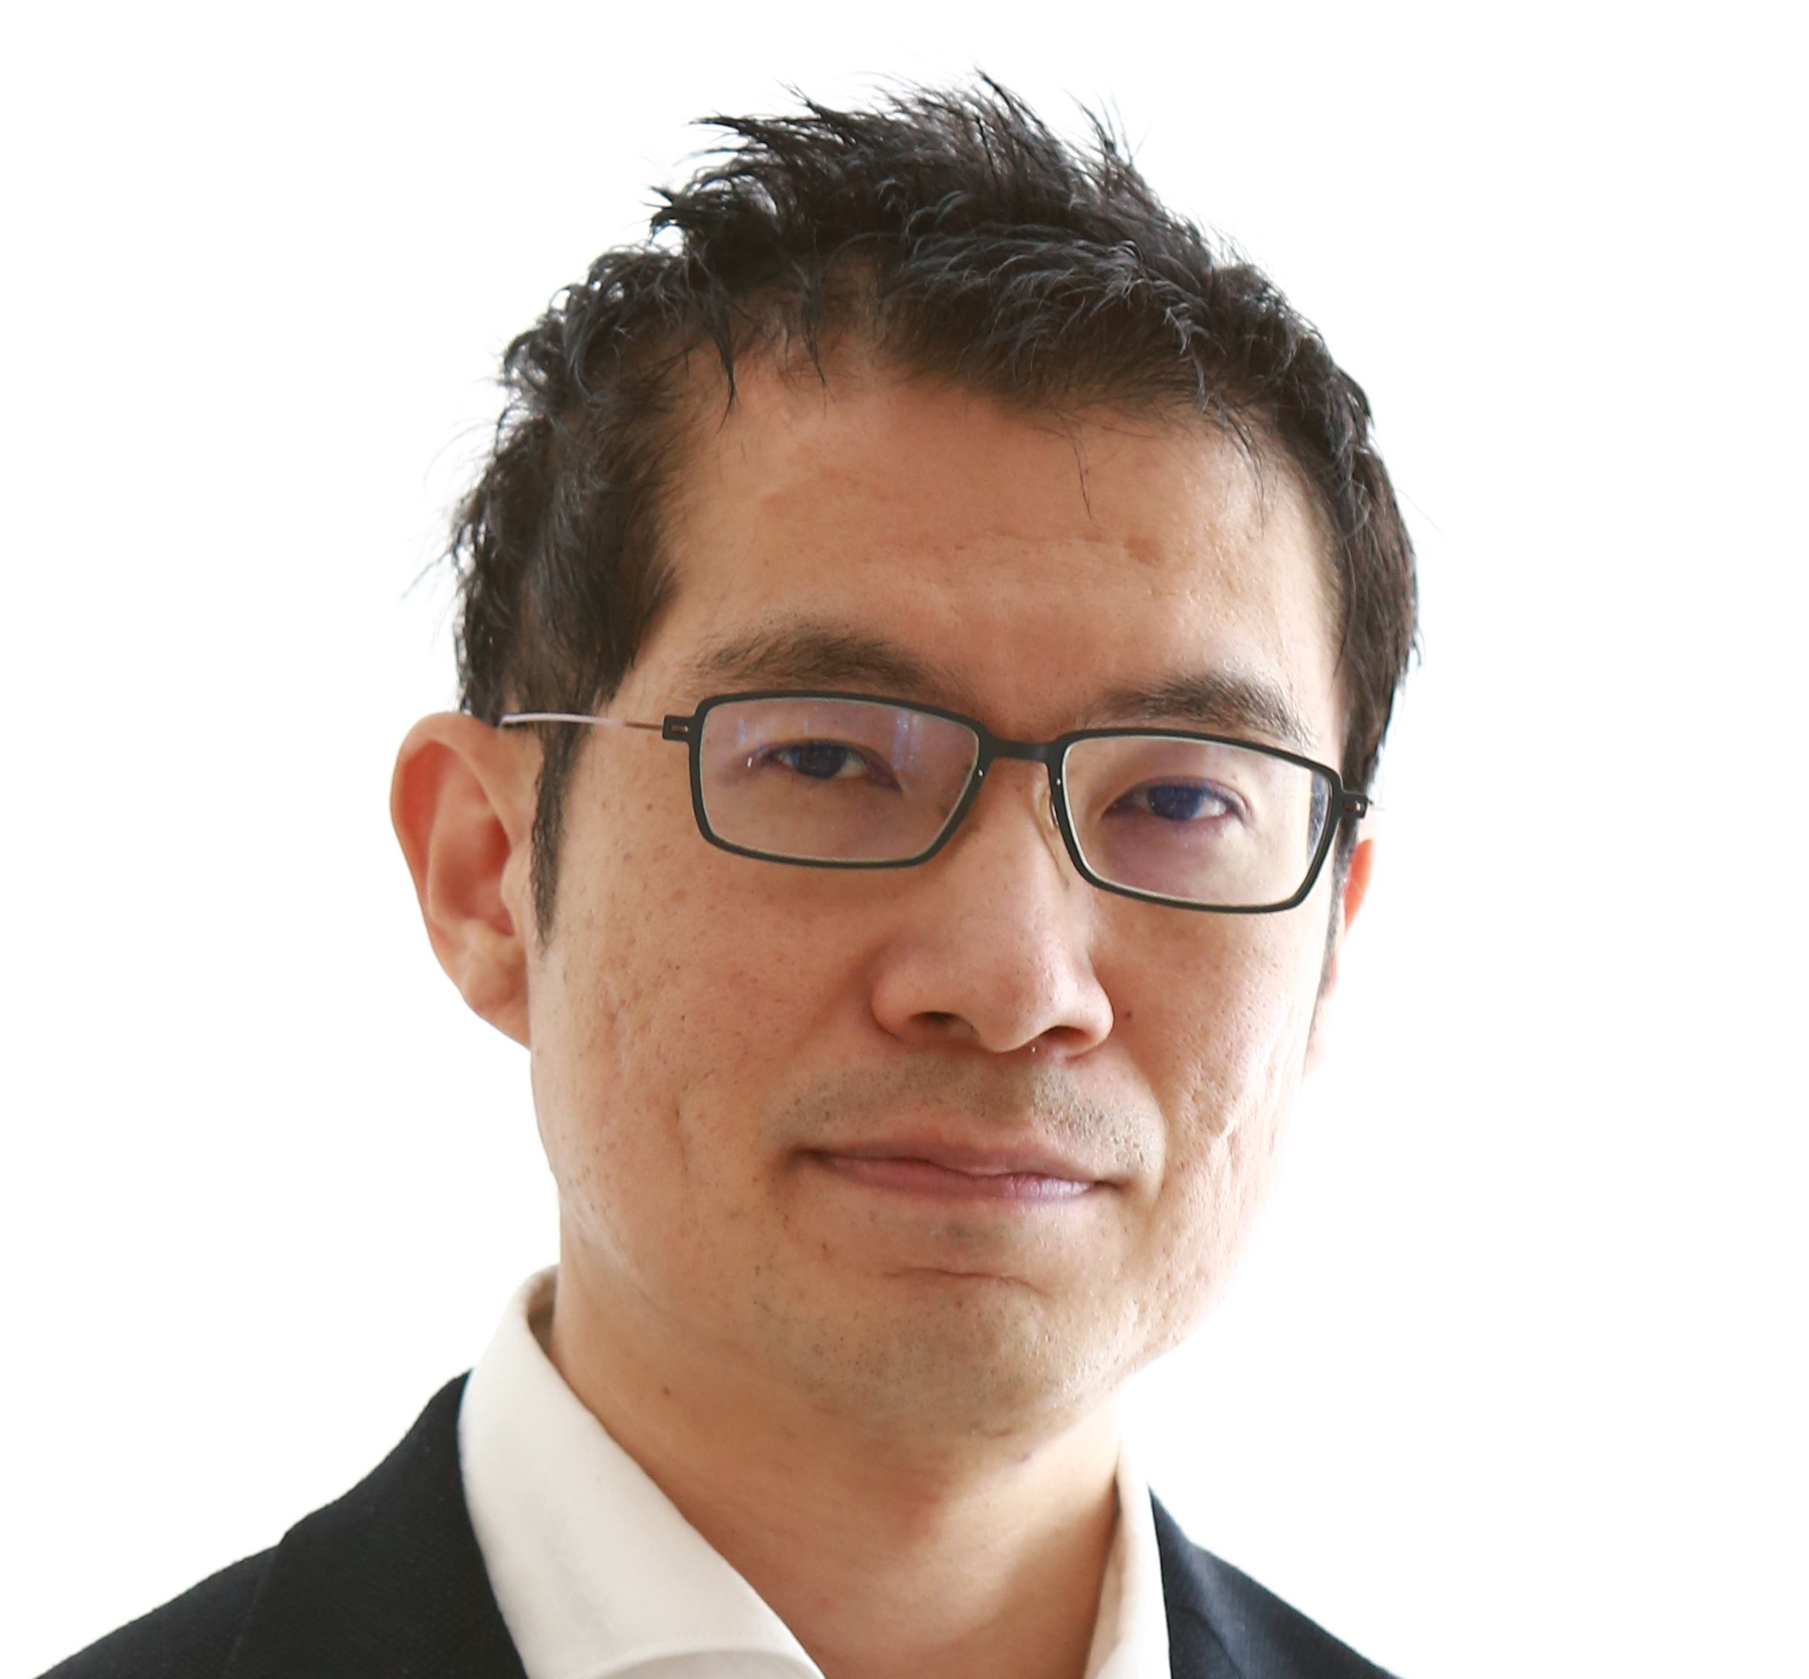
Tachio Terauchi
Professor at Department of Computer Science and Engineering, Waseda University, Japan
Research Interests
Program analysis, verification, and synthesis
Mathematical logic and automated deduction
Formal languages and automata theory
Type systems
Security

Slide 27
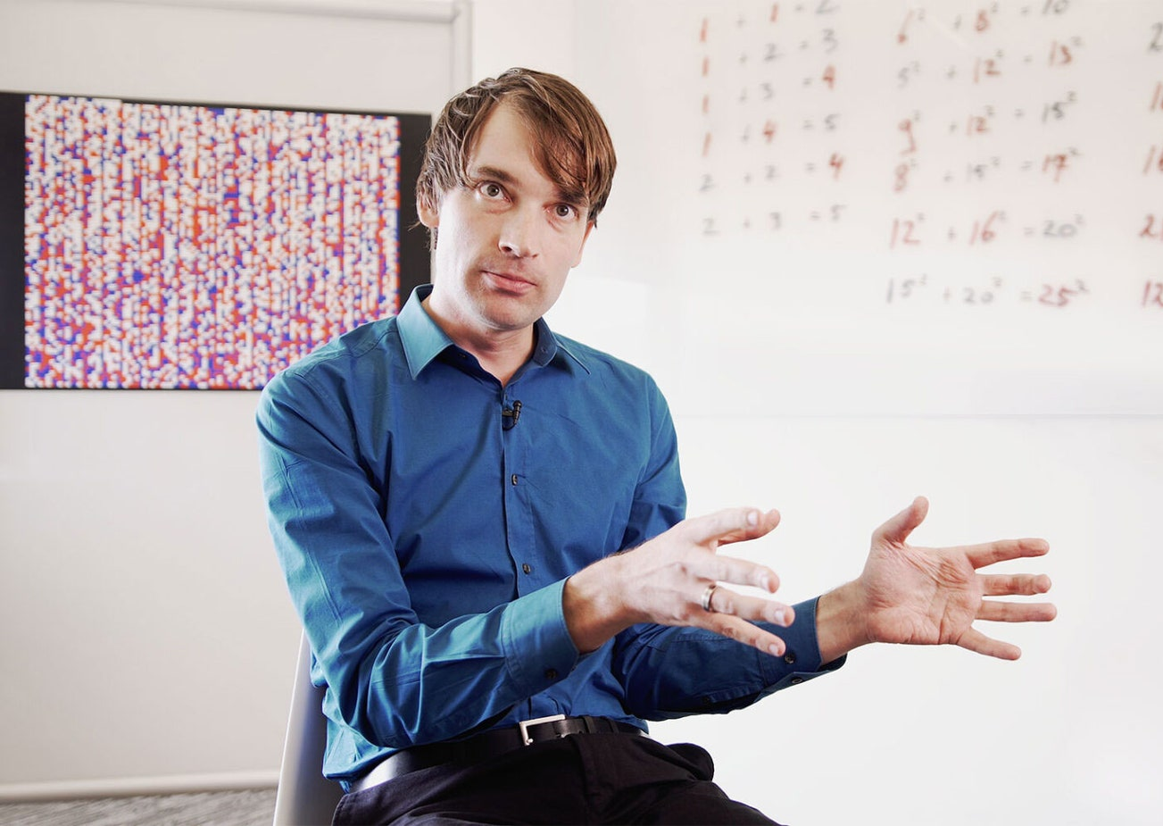
Marijn Heule
Carnegie Mellon University
marijn@cmu.edu
Research interests:
- Theory and practice of SAT solving - Trusted computing and certificates - Computer-aided mathematics

Slide 28
Nikolaj BjØrner
Microsoft
https://github.com/z3prover/z3
https://microsoft.github.io/z3guide

